Slide 1

Welcome to Tech Tales!
Session 5

Slide 2
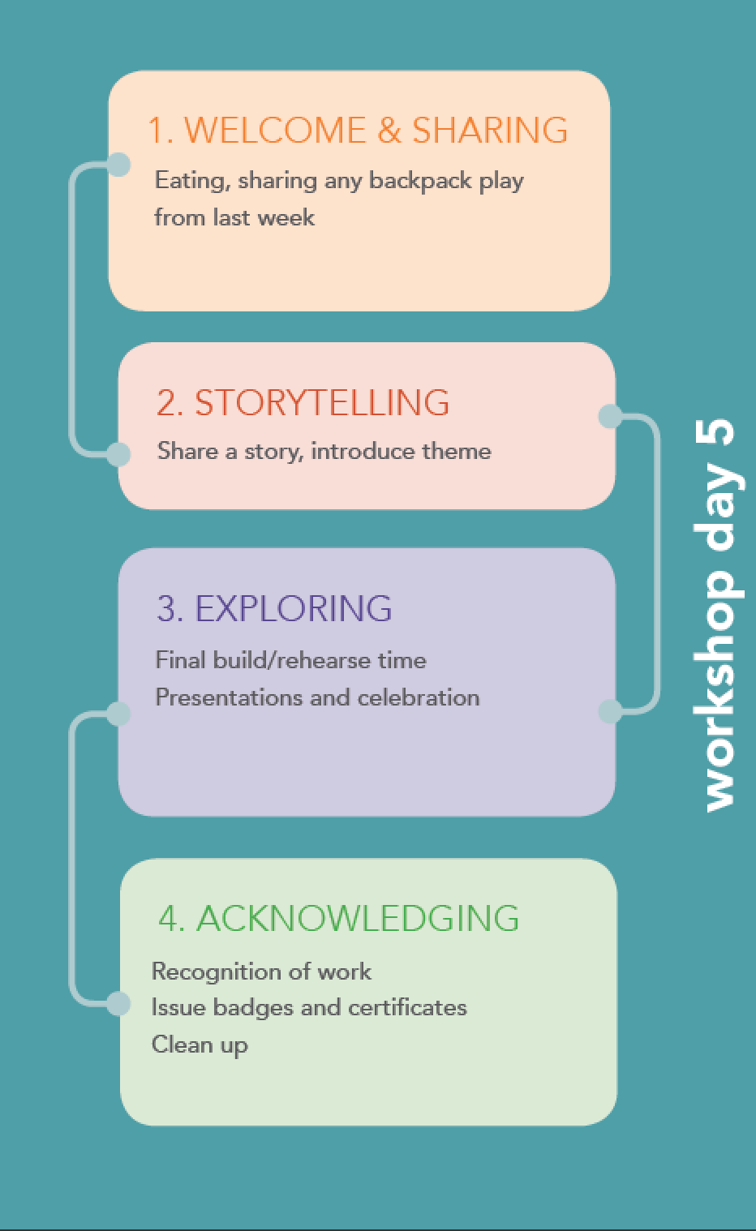


Slide 3






Welcome to Tech Tales Session 5!
Did you work on your diorama at home? What work did you do?

Slide 4
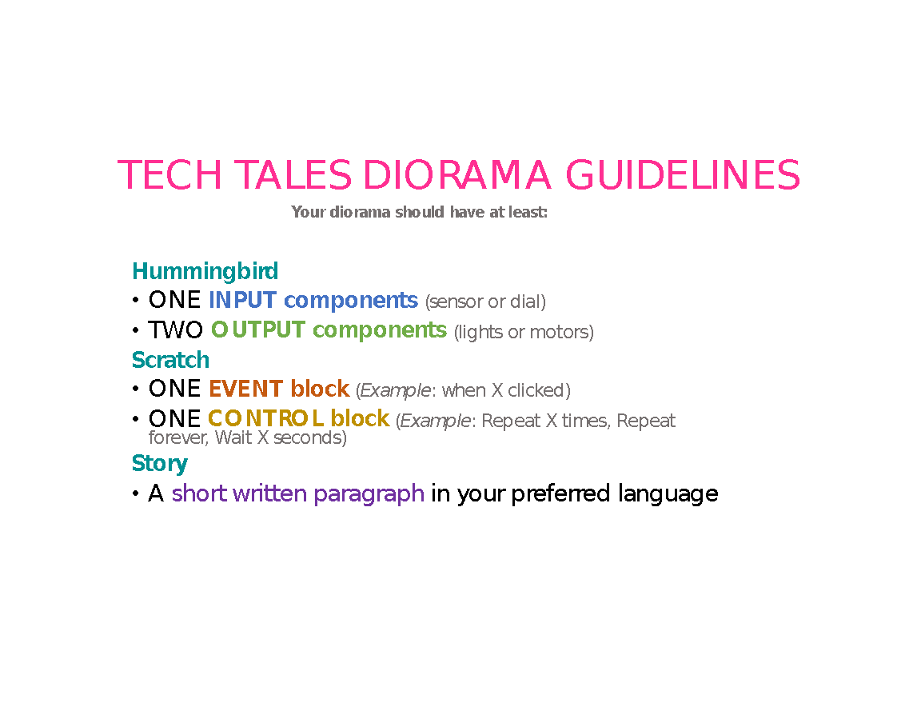

Slide 5
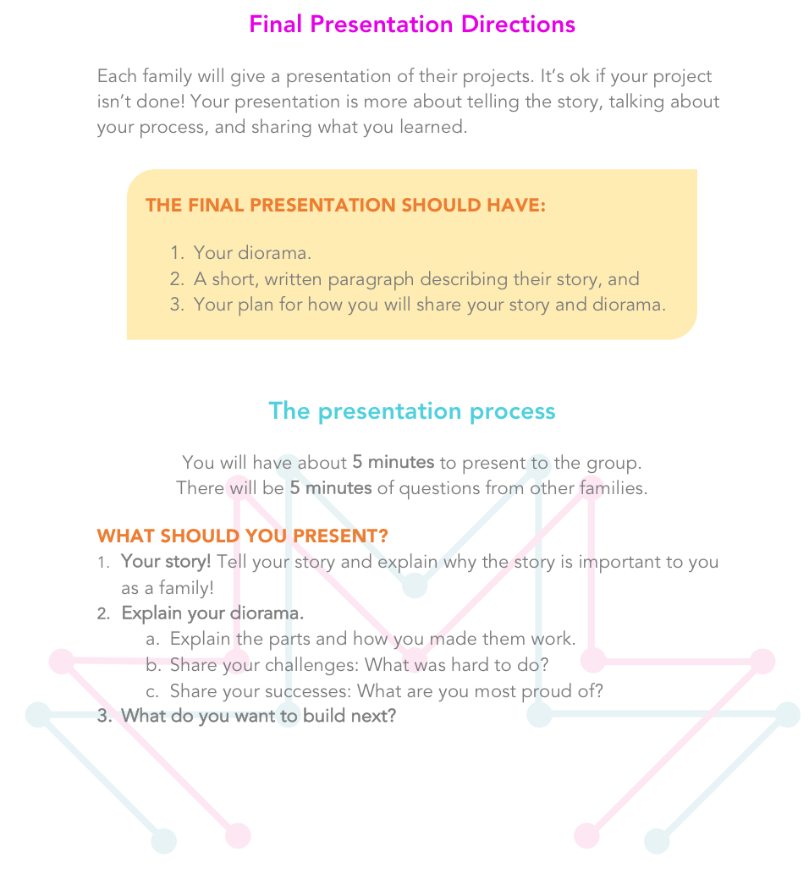

Slide 6
Congratulations!
Great work!

Slide 7
What’s Next?
Check in your backpacks
Video of presentations and family photos
Booster days
Pacific Science Center passes
Notes:
Gather up your equipment and turn in the backpacks to Amy or Ashley. They will check them to make sure the computer, camera, and Hummingbird containers are there. Please let us know if anything is broken or missing so we can fix it up before the next workshop.
We will be giving you a video of your final presentations on a DVD and a copy of your family photo. Philmon and Charlotte will be in touch to get them to you.
We will be having one day to practice what you learned with robotics in the Spring, so stay tuned for more information!
Pacific Science Center is happy to have you visit and is providing passes for your families.

