Slide 1

Welcome to Tech Tales!
Session 4

Slide 2
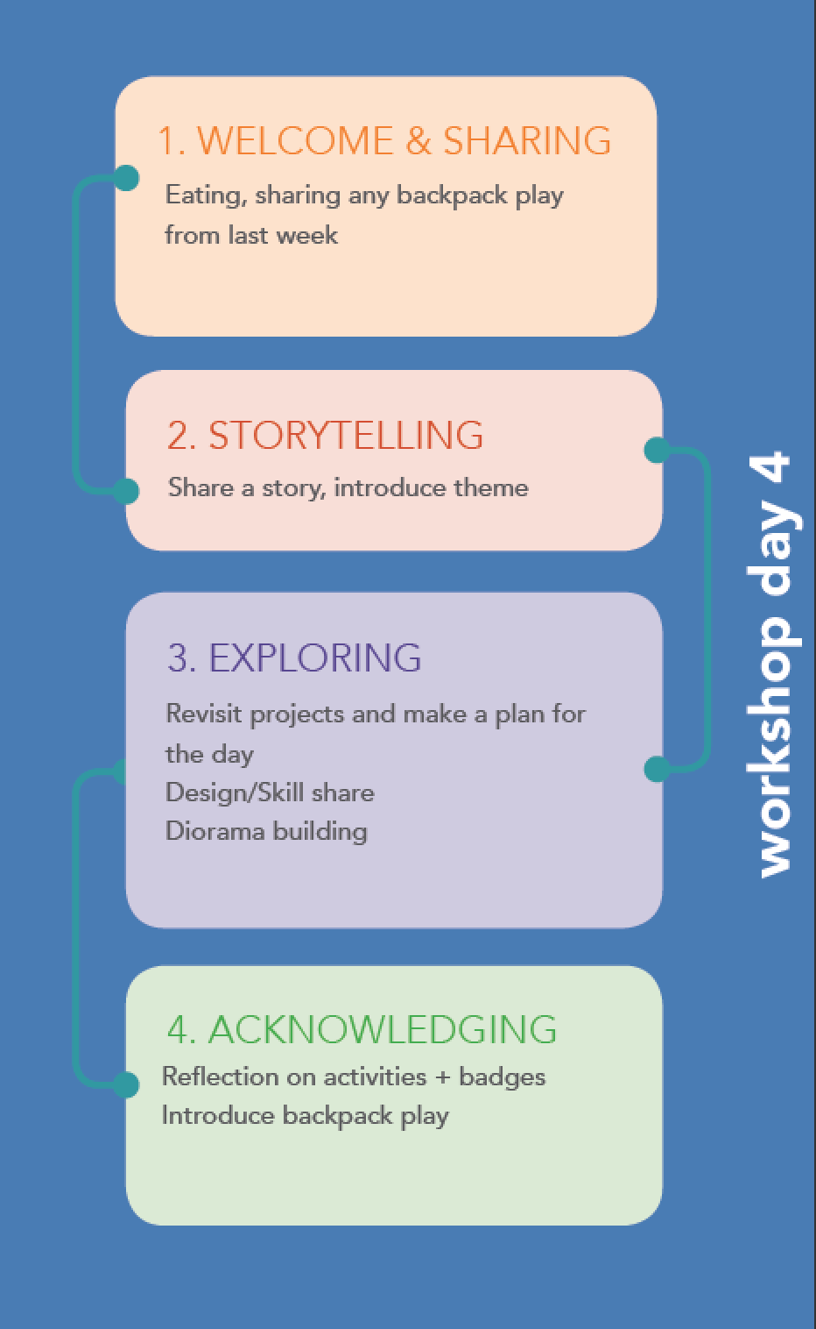


Slide 3
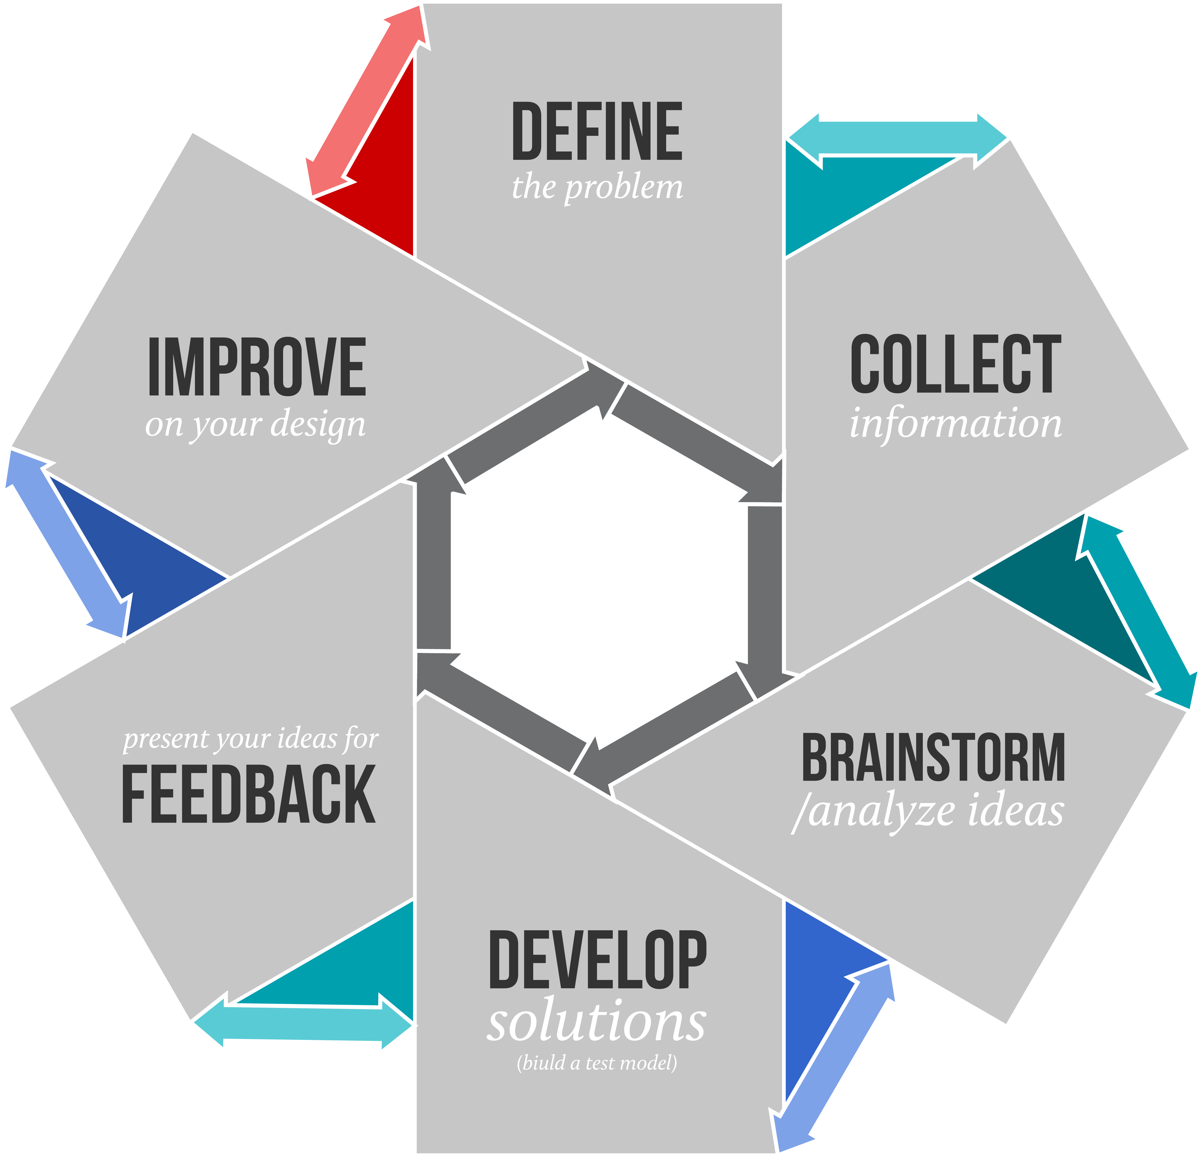
What is design?
The Design Process is an approach for breaking down a large project into manageable chunks.
Architects, engineers, scientists, and other thinkers use the design process to solve a variety of problems.

Slide 4
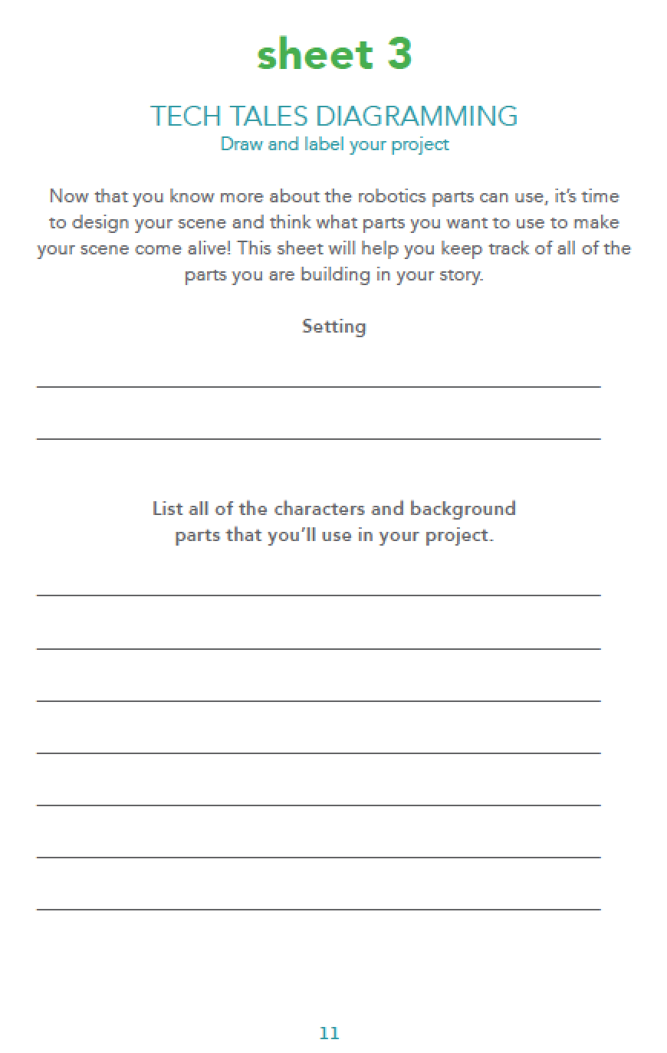
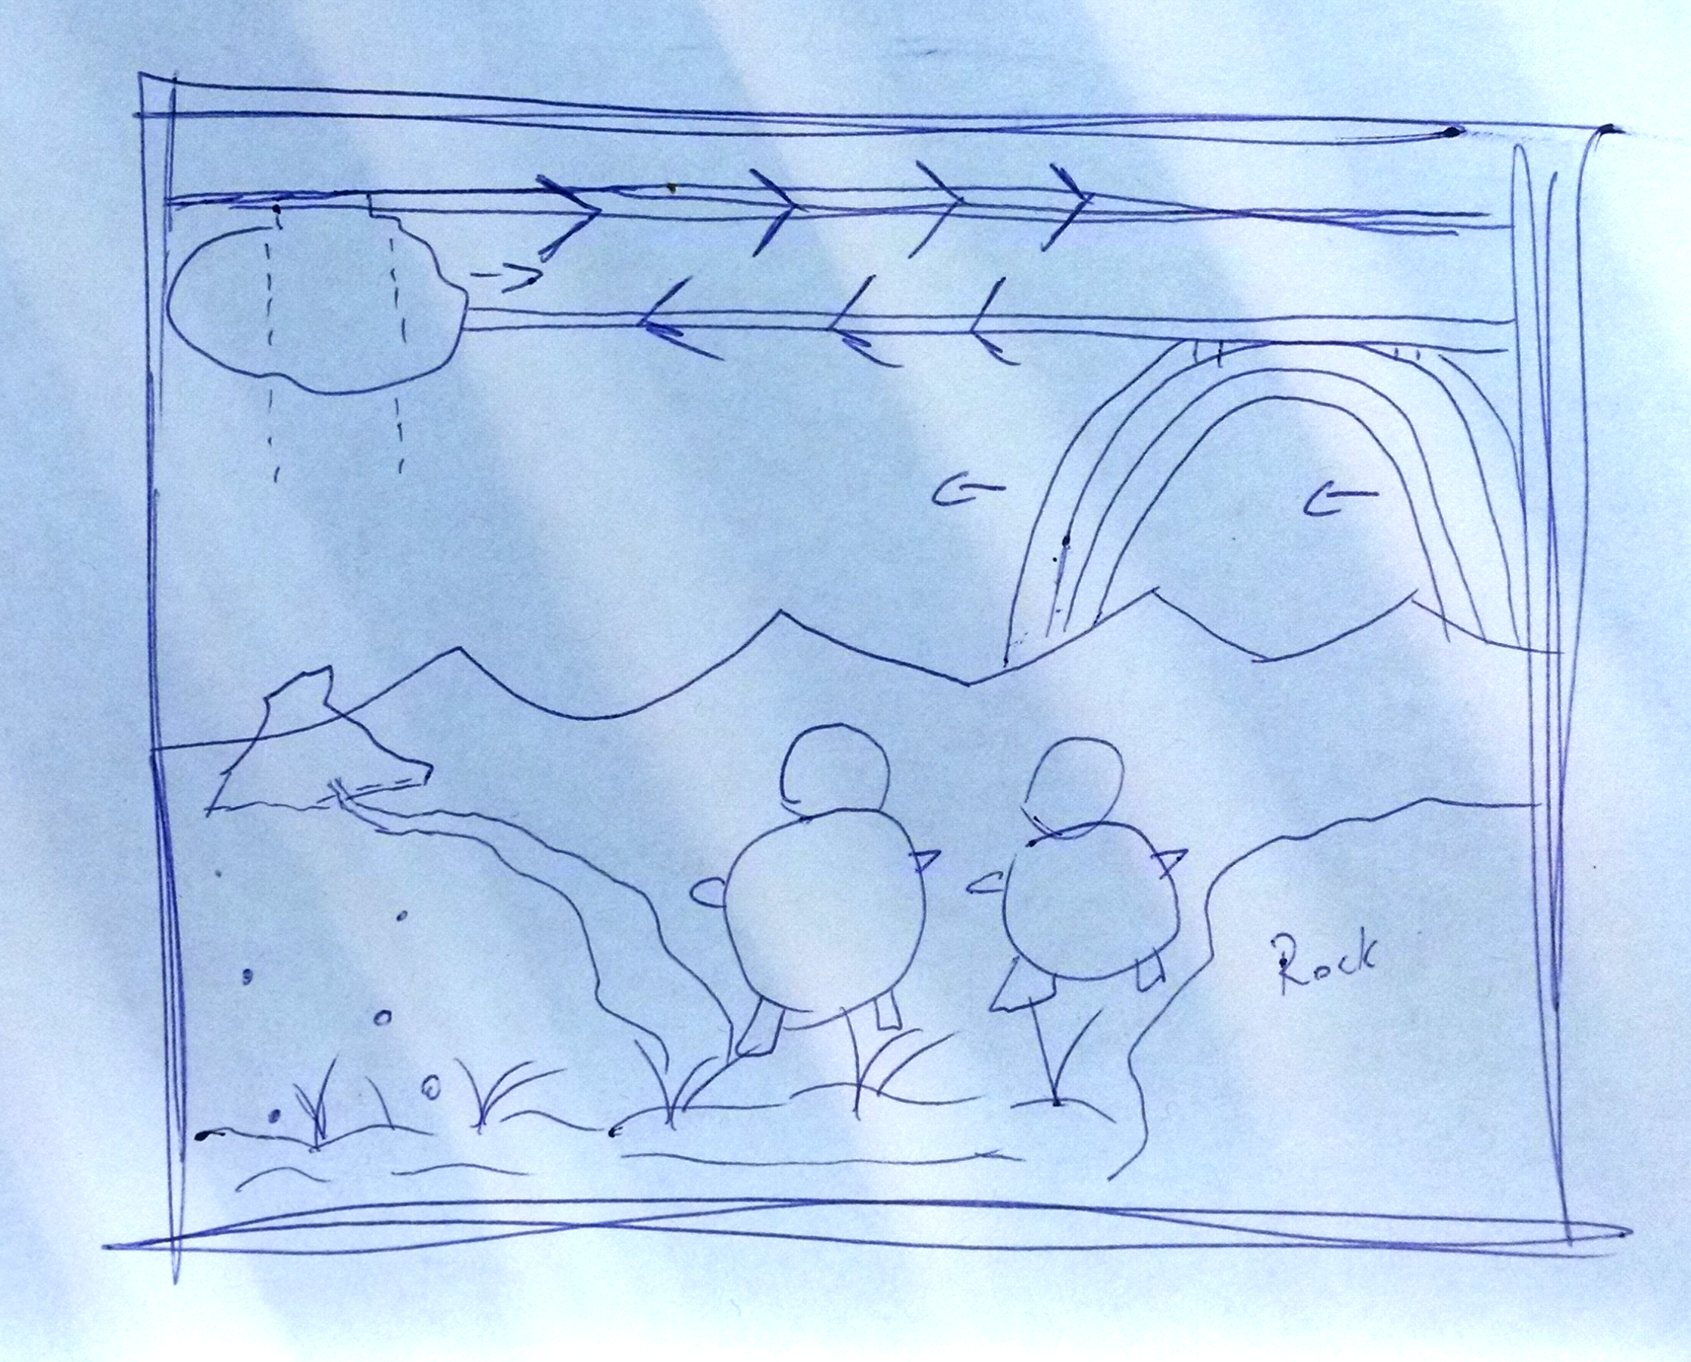
Your Story
Mountains with a trail, big rock
Two bears
Rainbow appears
Rain cloud moves

Slide 6
Wrapping Up…

Slide 7






Week 4 Badges

Slide 8
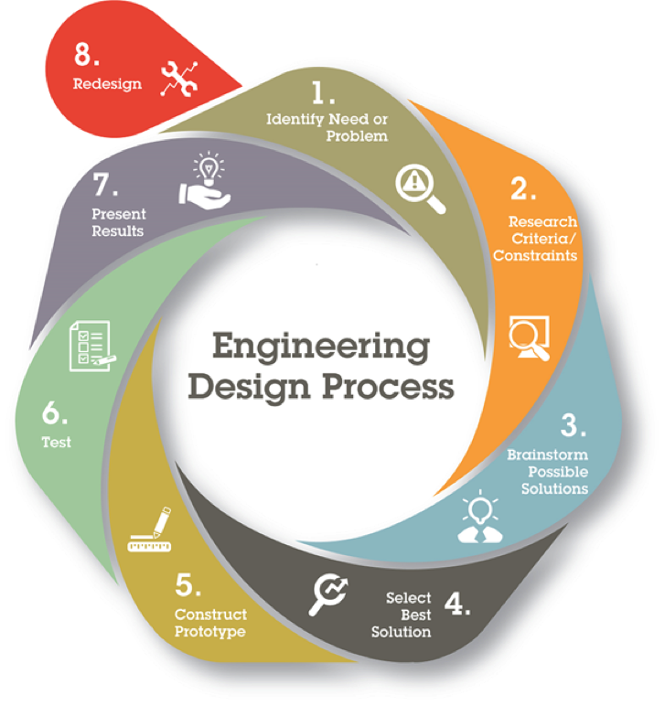
Do you design?
Have you ever come up with a plan to solve a problem, then revised how you would do something after you tested it out or learned something new?
New information, skills, tried a new material, asked someone’s opinion

Slide 9
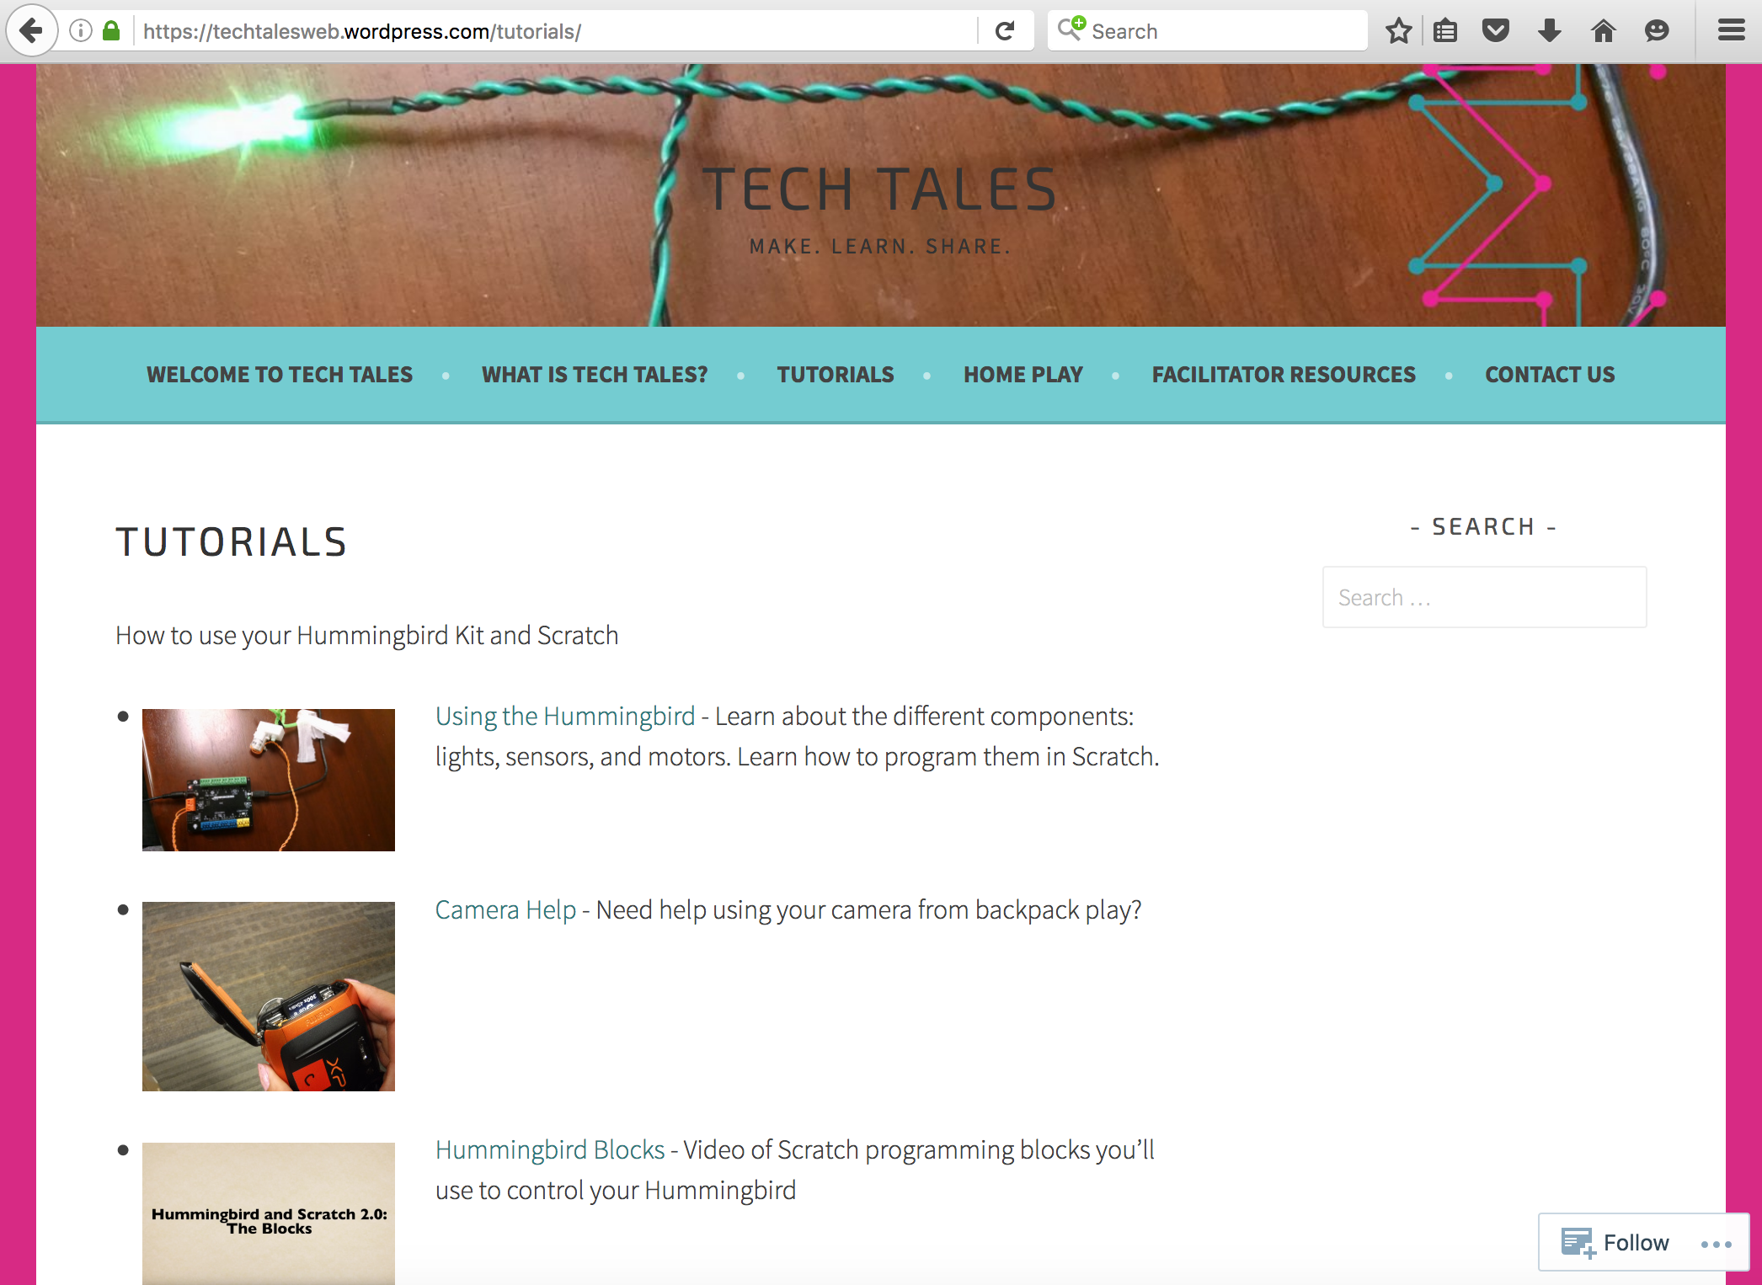
Hummingbird Help At Home
Notes:
If you need help with your Hummingbird, camera, or Scratch while you’re at home, you can visit the Tech Tales Tutorials webpage. The address is on the back of your name tag.
There are videos and instructions to help you out. If you’re still stumped, feel free to use the contact form to send us an email, or ask Amanda

