Slide 1
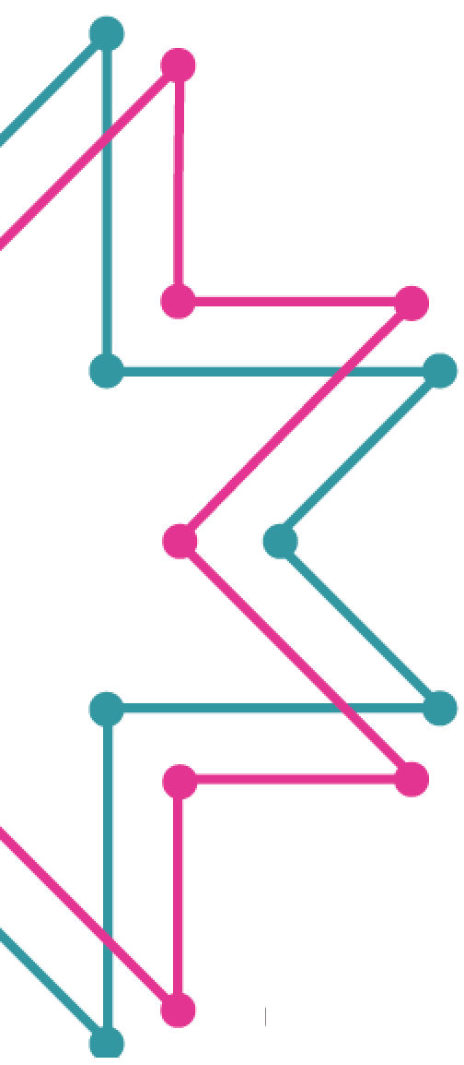
Welcome to Tech Tales!
Session 3

Slide 2
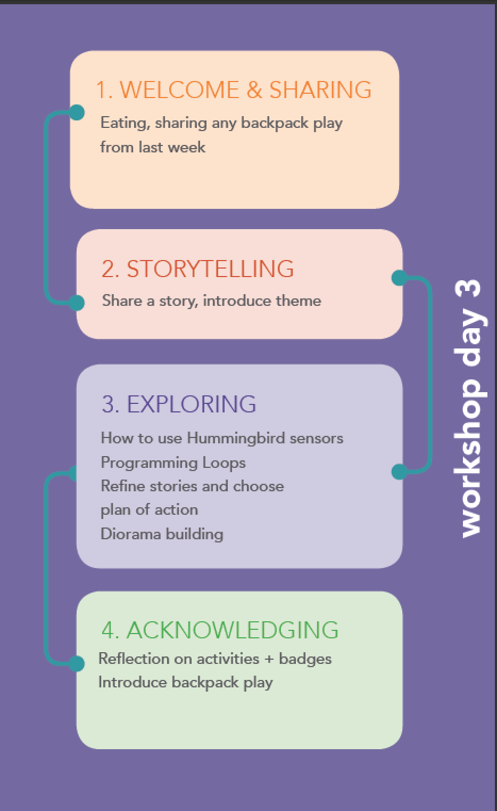
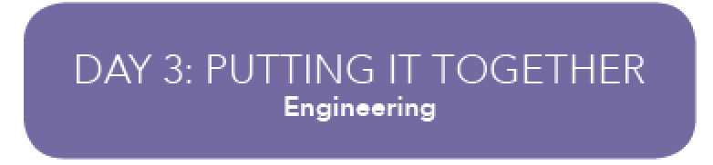

Slide 3

Welcome to Tech Tales Session 3!
Did anyone take pictures of their hobbies?

Slide 4
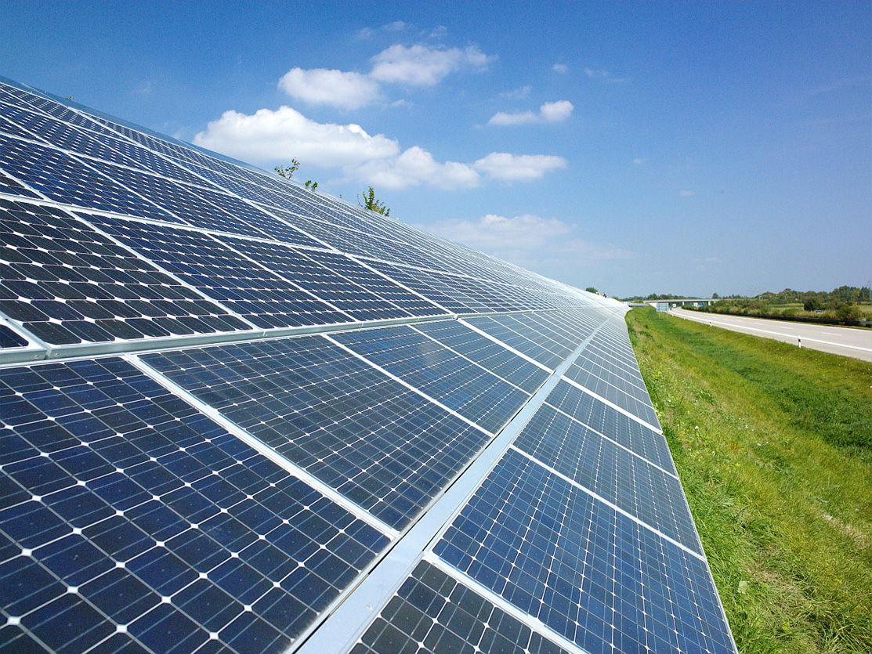
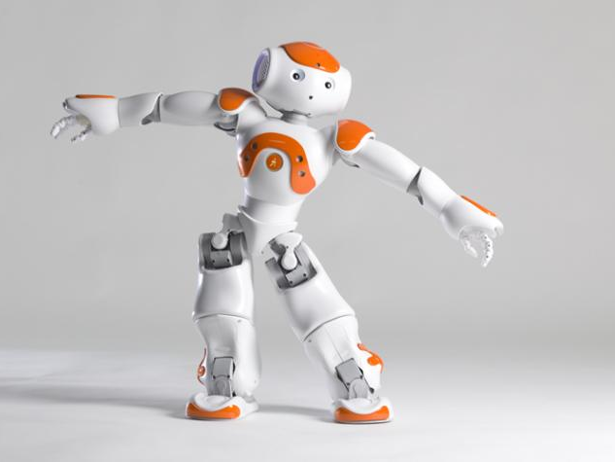
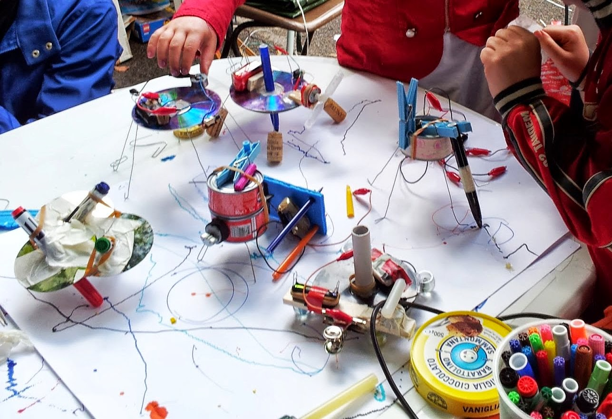
What is an engineer?
Engineers design solutions for people’s problems. They design roads, buildings, and bridges. They also design running shoes, roller coasters, and computers!

Slide 6
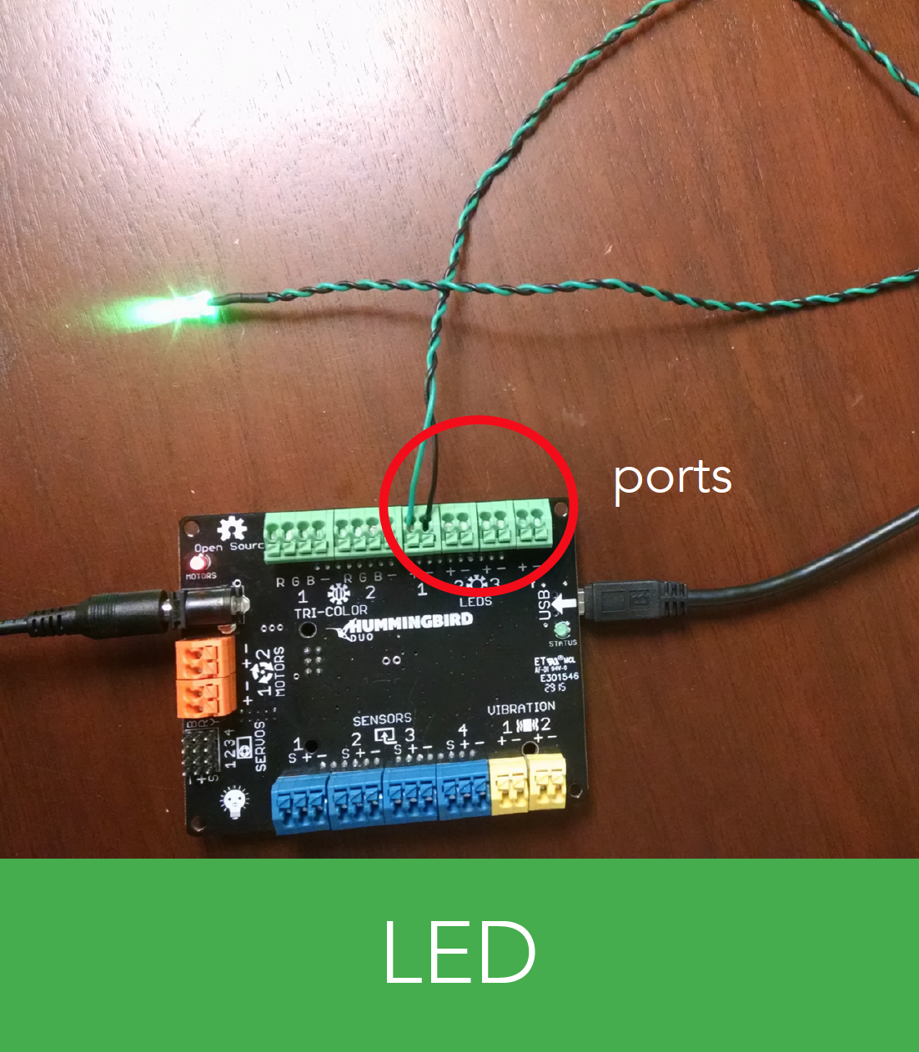
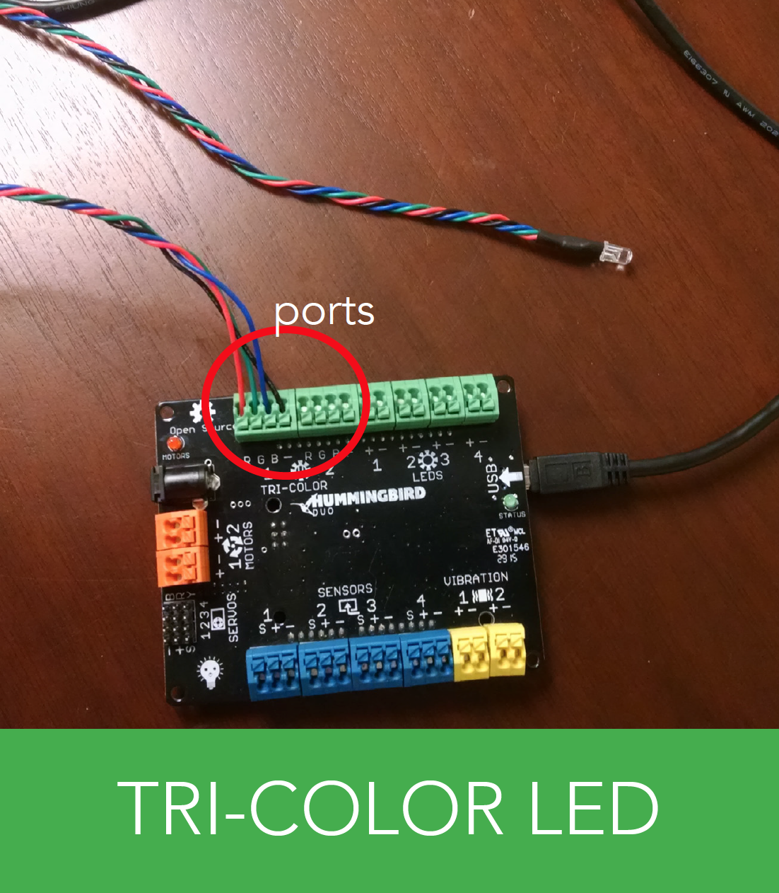
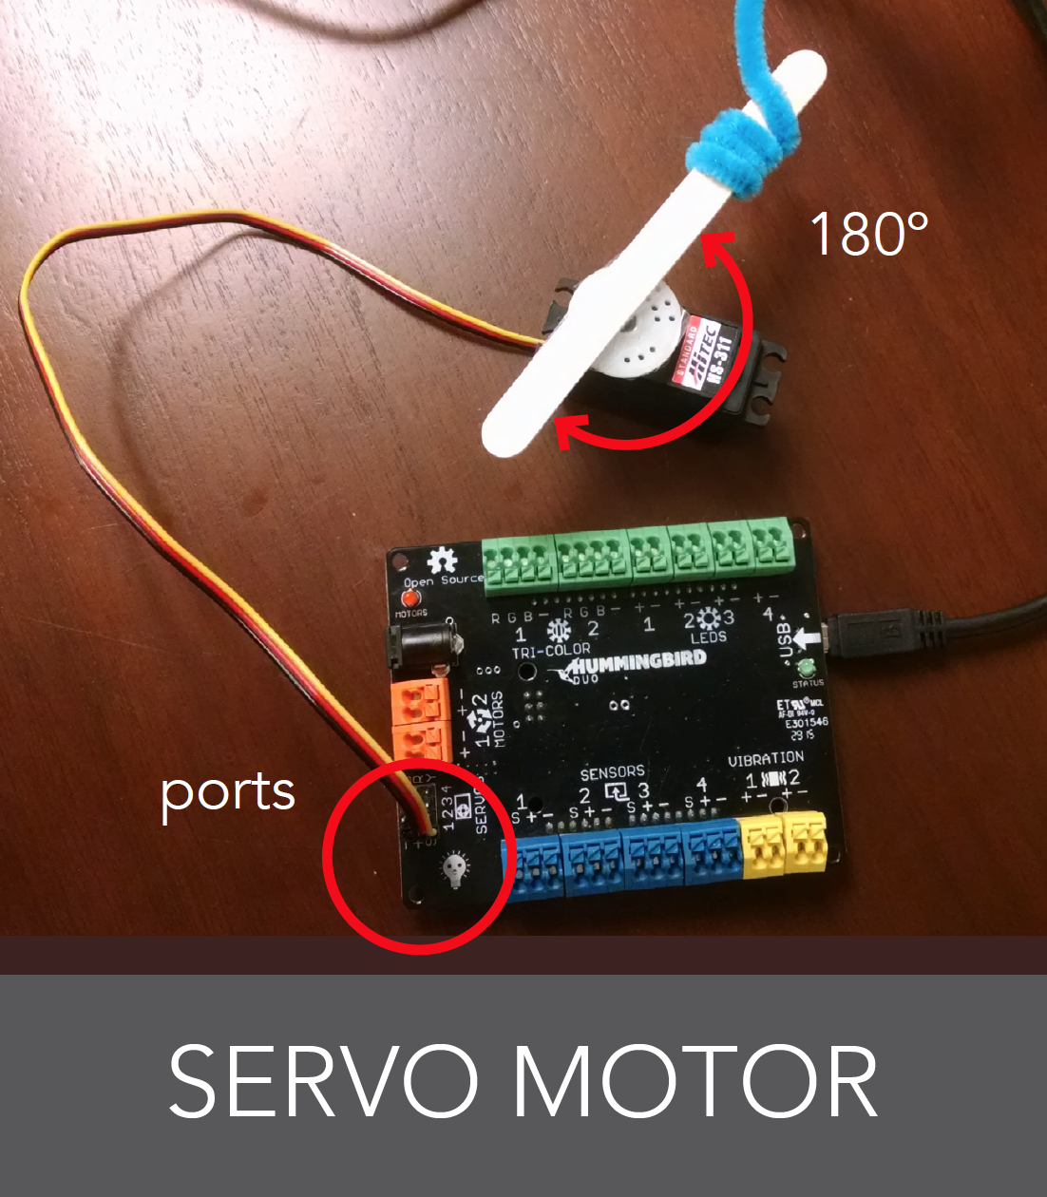
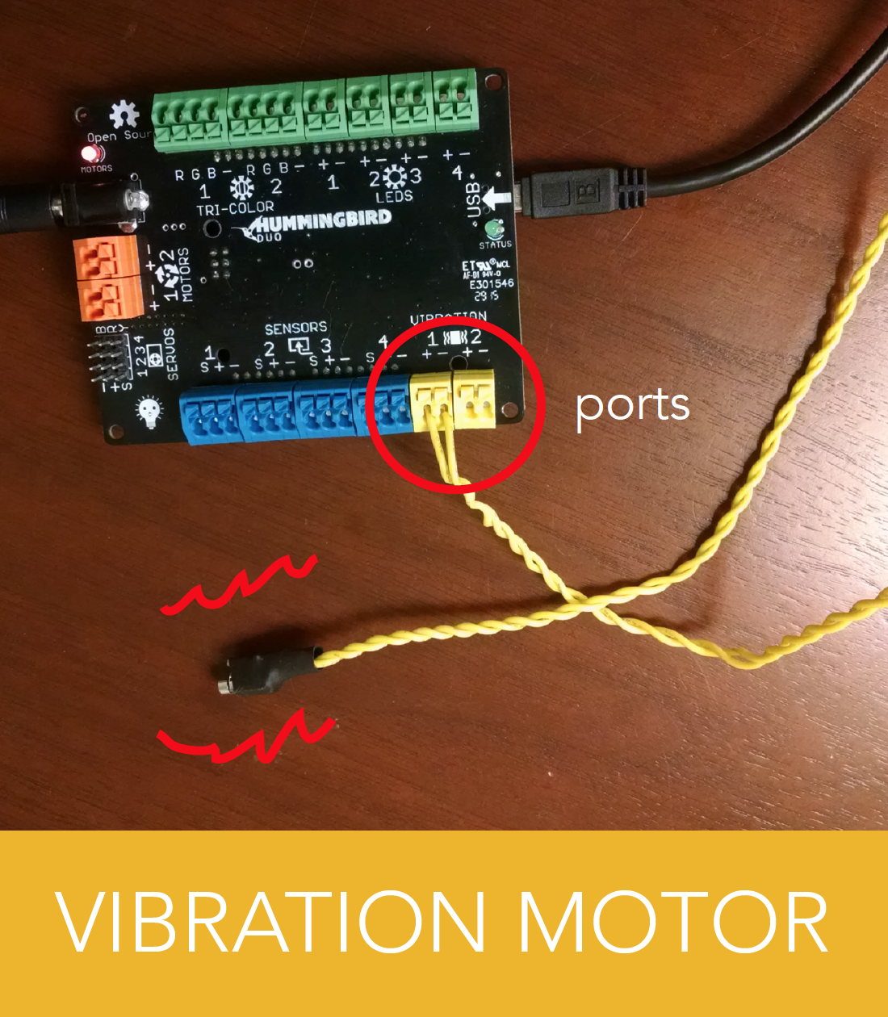
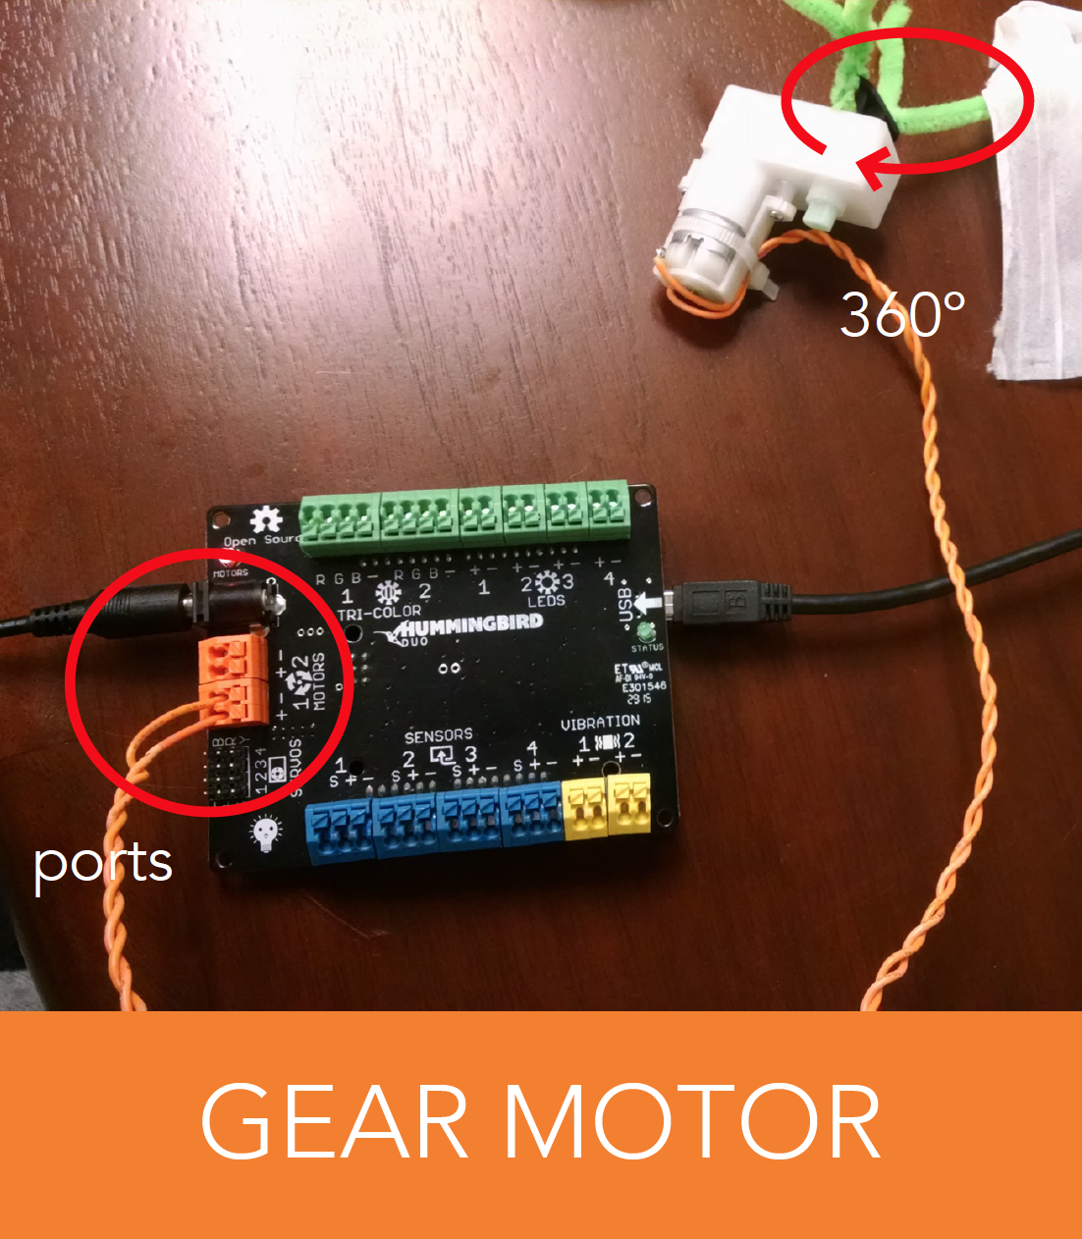
Hummingbird Output Components (LEDs, motors)

Slide 7
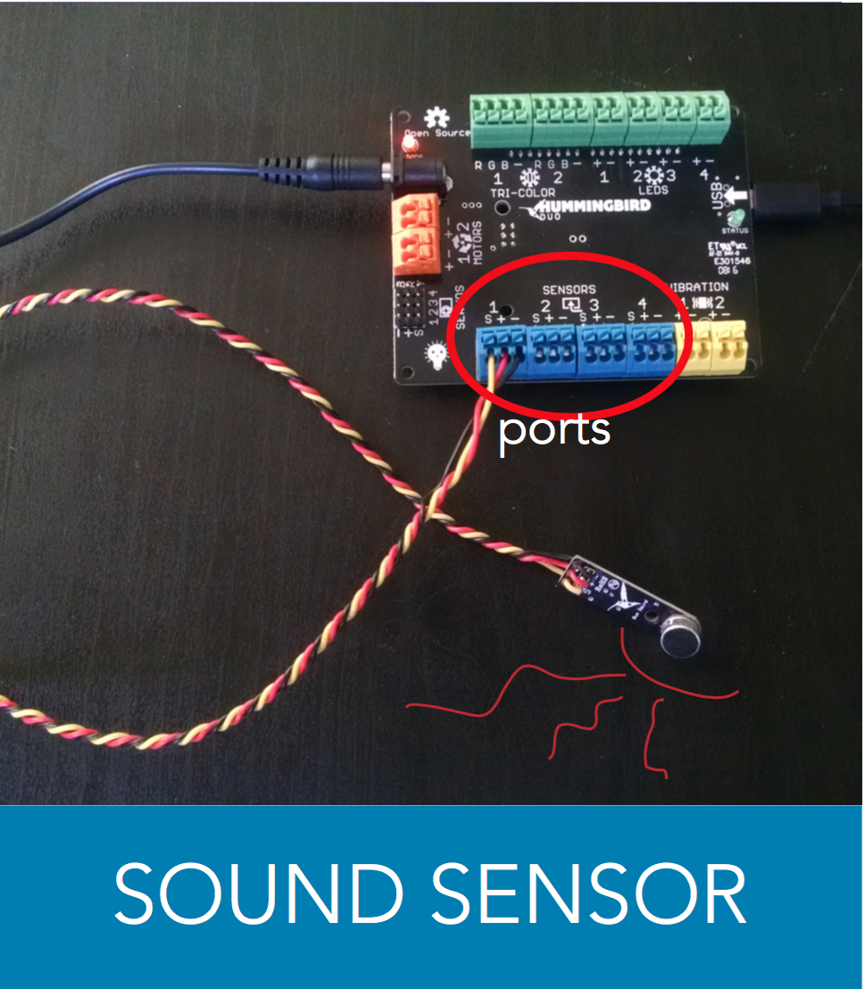
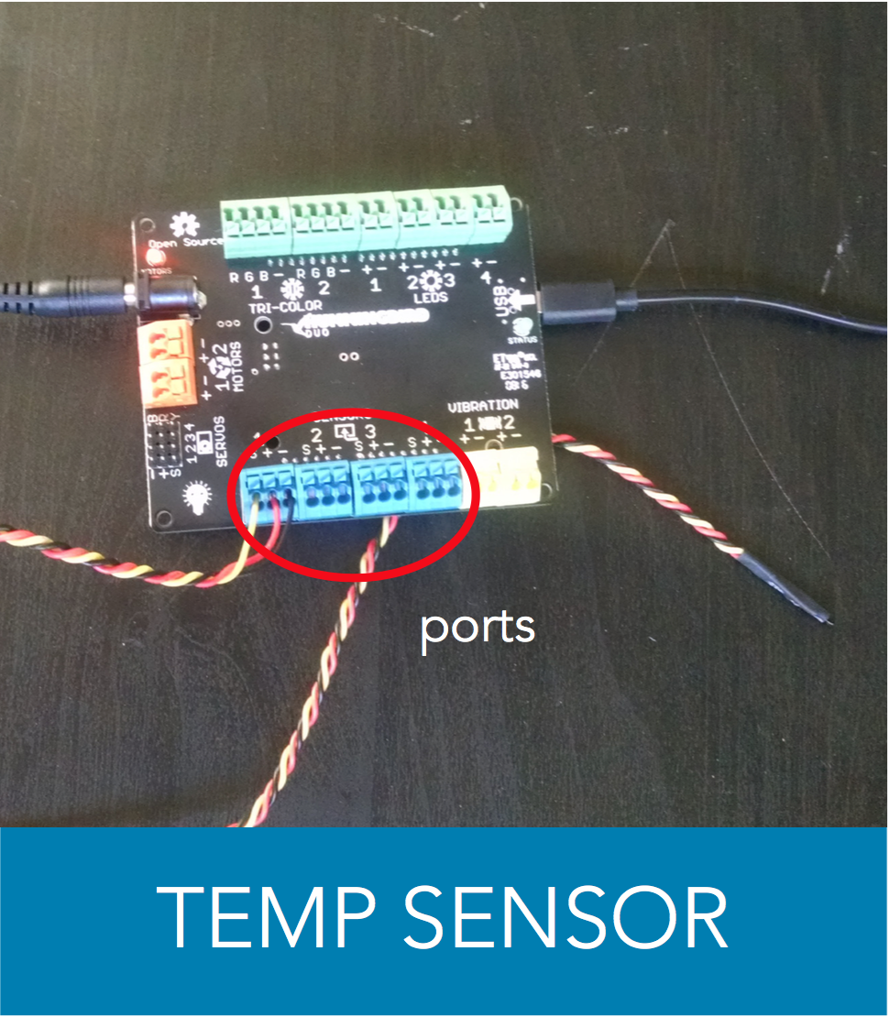
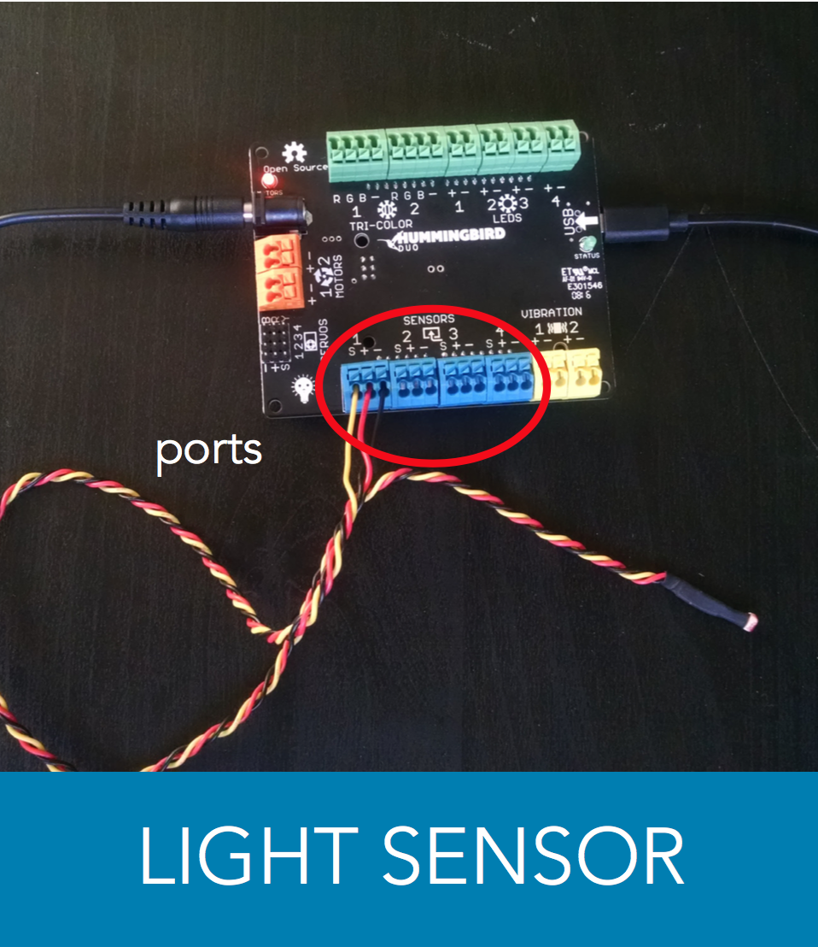
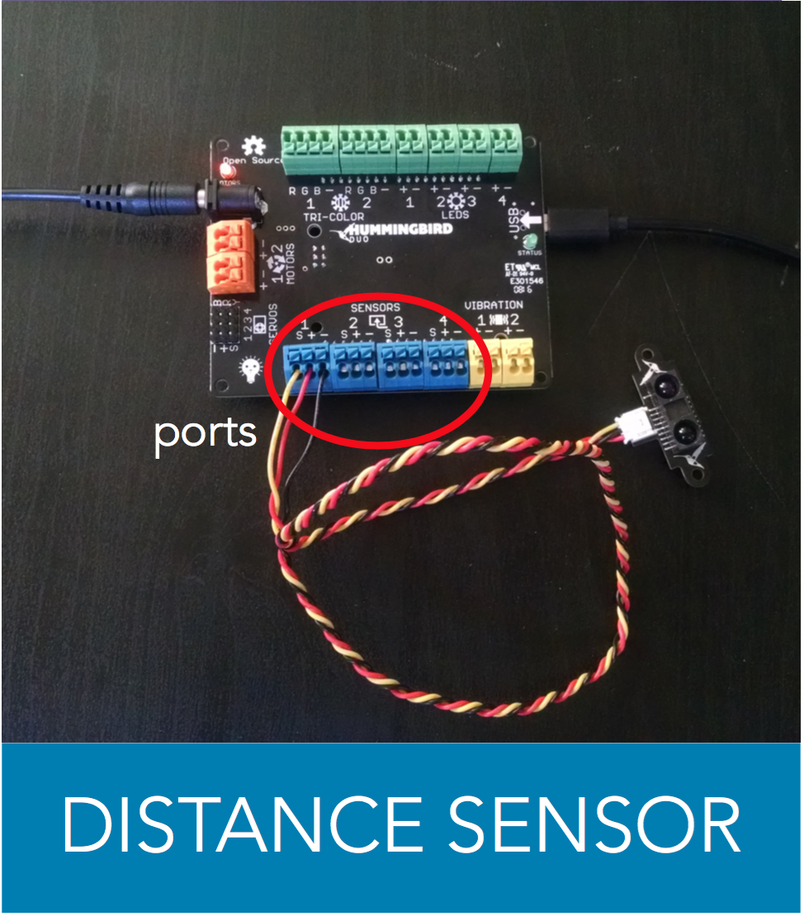
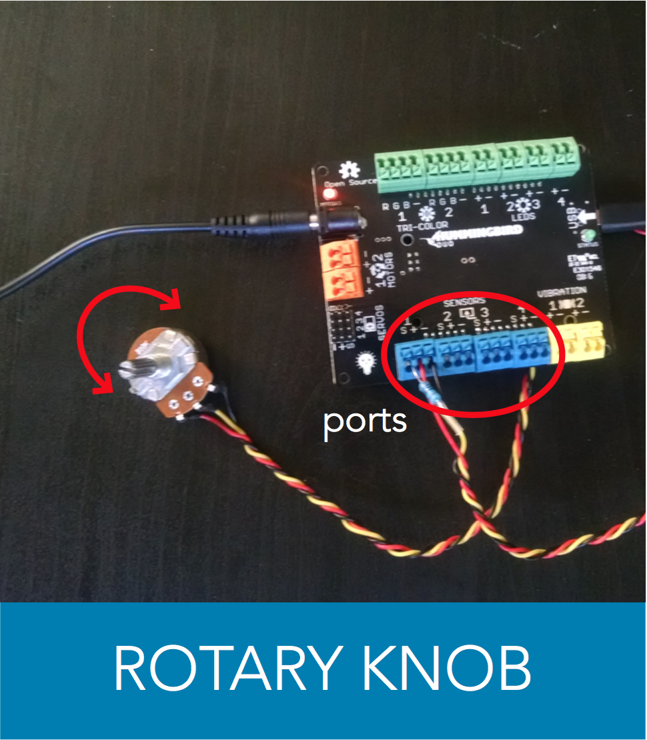
Hummingbird Input Components (sensors)

Slide 8
Inputs
Notes:
The Hummingbird sensors are input devices. They send information to the Scratch program.

Slide 9
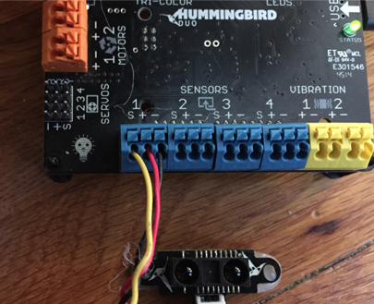
Distance Sensor attached to Sensor port 1
Black wire is always NEGATIVE (-)
Red wire is POSITIVE (+) on sensors
Yellow wire sends information (S for serial data)
Notes:
These port numbers are how we let the Hummingbird and Scratch program talk to each other. It’s like sending a letter to an address.
The positive and negative wires make a complete circuit.
The yellow wire takes the input that sensor receives and sends it to the Hummingbird.

Slide 10
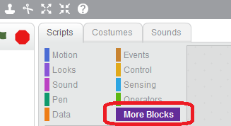

Sensor blocks
Click to see value the sensor is picking up
Notes:
Find the Hummingbird blocks under More blocks under the Scripts tab. They are purple.
Find the block that says HB distance sensor and drag it into the right gray part of the screen.
Click on it to find out what value it is sensing. The numbers are distance in centimeters.

Slide 11
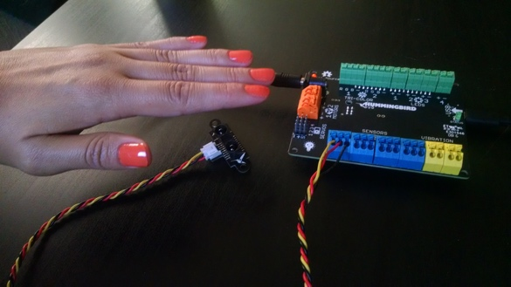

Hold something in front of the sensor and click the block again.
Is the number different?
This is the distance it is sensing in centimeters.
Notes:
Keep the sensor still in one place and hold something in front of it.
**This is an infrared sensor. It sends a beam of infrared light out and measures how long it takes for the beam to be reflected back. This is how it measures distance.

Slide 12
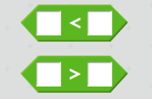
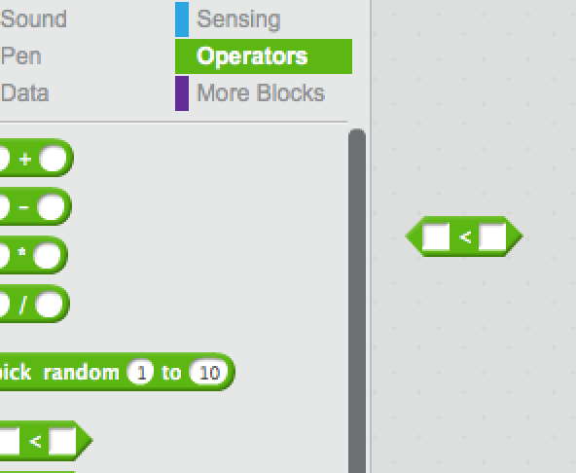
Sensor as a switch
Use the distance sensor to trigger an action
Less than
Greater than
Notes:
Find the Greater and Less Than blocks under the Operators menu. They are green.
Hungry alligator wants to eat the bigger number:
Mouth open to the right is less than (First number is less than the second number)
Mouth open to the left is greater than (First number is greater than the second number)
(Or Arrow points to the smaller number)

Slide 13

Comparing Values
How far from the sensor do you want something to be to trigger an action?
Input from distance sensor
Greater than
30 cm
Notes:
Drag the distance sensor block into the first open square of the comparing block.
The value that the Boolean block uses to make a decision is called the threshold.
In this case, the threshold is 30 cm.
Create the Boolean block shown. This block is true if the value of the distance sensor is greater than 30 cm, and false otherwise.

Slide 14
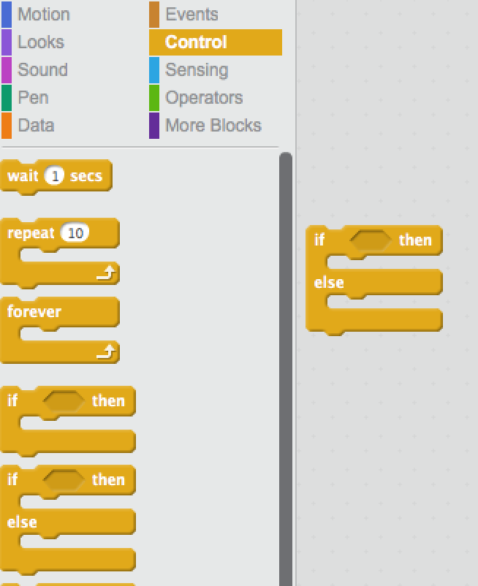
Test
Test if the condition we set is true, and do something
If (this is true)
Then (do this)
Else (do this other thing)
Notes:
We have blocks that do comparing, but it doesn’t actually make anything else happen. We want to do something with that information! For that we need some controls.

Slide 15
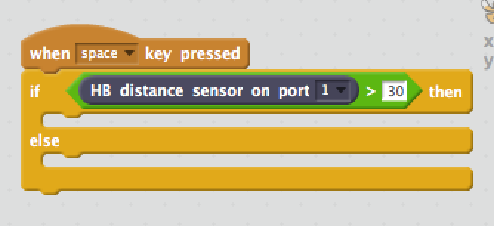
Test
When space bar pressed,
Test if
Distance sensor value is
Greater Than
30 cm
Then (do this)
Else (do this other thing)
Notes:
We have blocks that do comparing, but it doesn’t actually make anything else happen. We want to do something with that information! For that we need some controls.
Choose the If/Else/Then block (NOT the If/Else block)
Drag your green diamond into the IF section of the block.
We are setting an event, telling the hummingbird to listen for the space bar to be pressed.
When that happens, it tests if the input from the distance sensor is greater than 30 cm.
Now let’s make something happen!

Slide 16
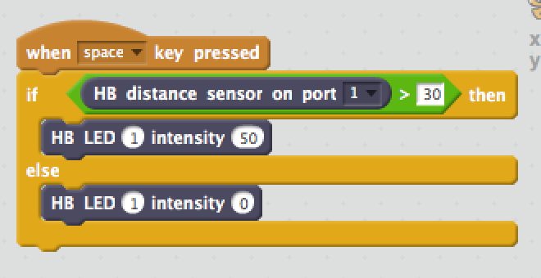
Make something happen
If this is true, then
Turn LED on half power
Otherwise,
Turn LED off
Notes:
We want to turn on the light if the sensor is triggered, but keep it off the rest of the time. This is like when you walk into a bathroom with a motion sensor. The light is off unless the sensor is triggered. ”Else” is the default.
Drag your LED blocks into the “jaws” of the if/else block. The first block will be what happens when the statement is true, in this case, set LED at port 1 on to half brightness.
The second block will be what happens the rest of the time (set LED at port 1 off).
**motion sensors are sometimes infrared (IR) sensors like this one, or they may use sonar or laser. There are many ways to accomplish similar tasks, and different tools are better suited for certain tasks. This sensor is good for measuring objects right in front of it.

Slide 17
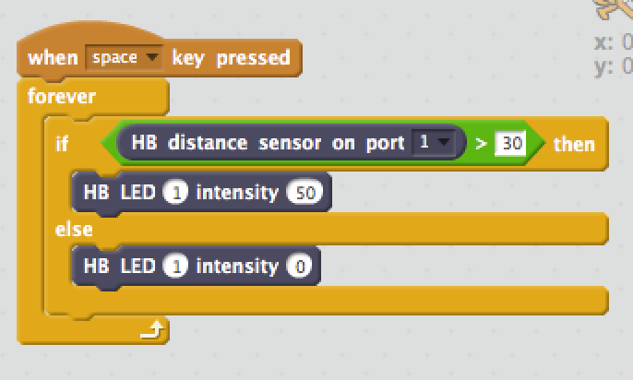
Keep doing it
Keep sensing forever
*This is important to make the sensor work
Notes:
Add a forever block around your actions to make it repeat forever in a loop.
We use the Forever block to keep the program running in a loop, continuing to sense distance.
If we did not use the forever block, the sensor would test the distance once, then the program would stop, just like when you clicked on the sensor block alone.

Slide 18
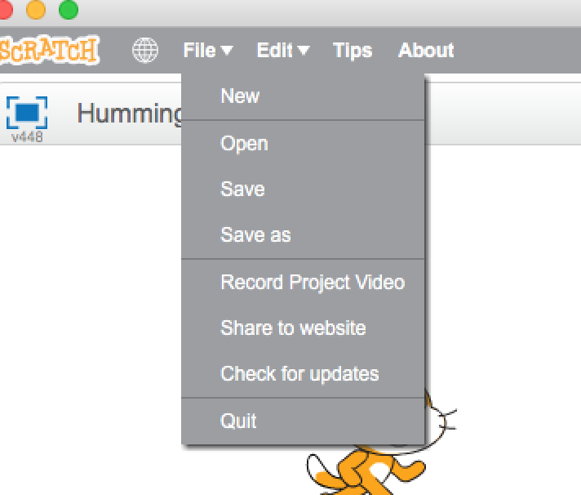
Save your program
Notes:
Save your program with a name that describes what it does, like distancesensor.sb2
Save it to a place that is easy to find on your desktop or under Scratch Projects.

Slide 19
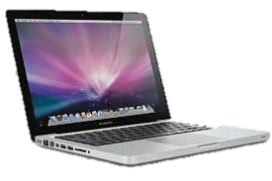
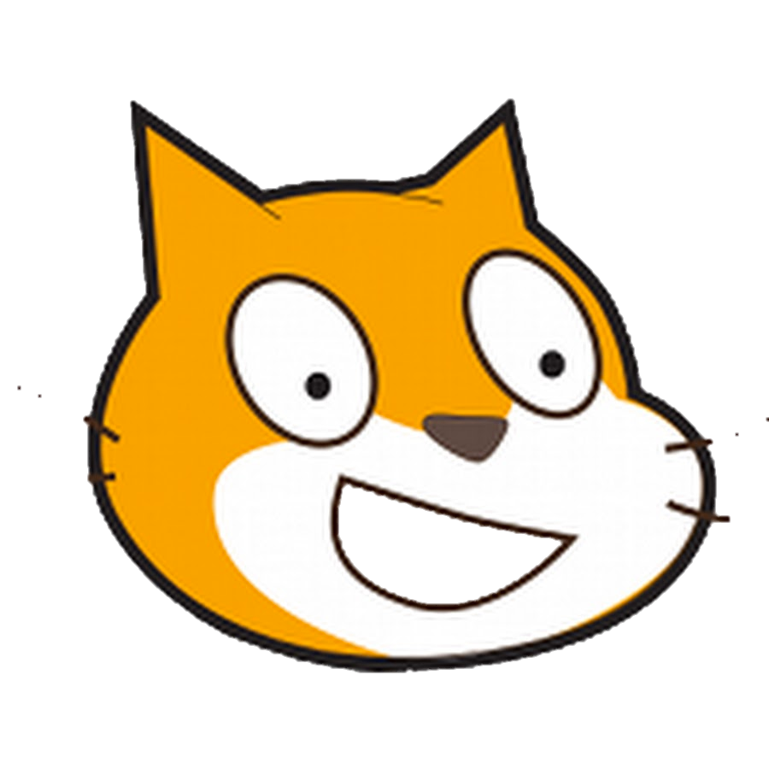
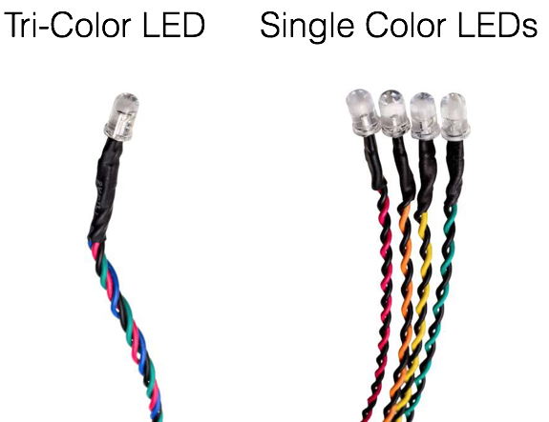
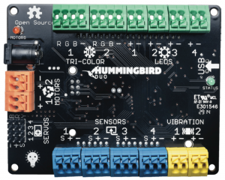
How does it work together? (A Model)
Program
(Scratch)
Storage
(on laptop)
Inputs
(sensors)
Runs a Process
(on Hummingbird)
Outputs
(lights, motors)
Notes:
We wanted to put all these different pieces we have been talking about together into a visual model. I’m going to show you a general model of how computers work. We are using two computers (devices with microcontrollers)—the laptop and the Hummingbird.
Here’s how our computer system works…
On our laptops we are writing programs in Scratch. Programs are designed to run algorithms—sequences of steps to accomplish actions, in the same way we have steps to brush teeth for our human robot. Computers have Storage components built into them so we can “Save” programs we want to keep.
We can then send (or “upload”) the program we write to the Hummingbird over the USB cable so that the program can be run on its microcontroller (the “brain”). (We do that when we trigger an event in the program)
One of the useful things that robotics (like the Hummingbird) can do is make Output components do things: perform actions like turn lights and motors on and off.
Robots (and computers) are more useful if they can take in information from the world. What happens in the world can trigger actions that the robot performs. Input components feed information into the microcontroller. With the Hummingbird, we can take in information from dials, light sensors, sound sensors, distance sensors, and temperature sensors.
BACKGROUND: Here’s the relevant WA state computer science standard we are focused on here…
1B-C-7-9 Model how a computer system works. [Clarification: Only includes basic elements of a computer system, such as input, output, processor, sensors, and storage.]

Slide 21
Wrapping Up…

Slide 22



What badges did your family earn?
Notes:
Each member of the family writes down their name and what they are most proud of that they accomplished during the workshop. When they turn in the sheet the family gets a family badge.

Slide 23
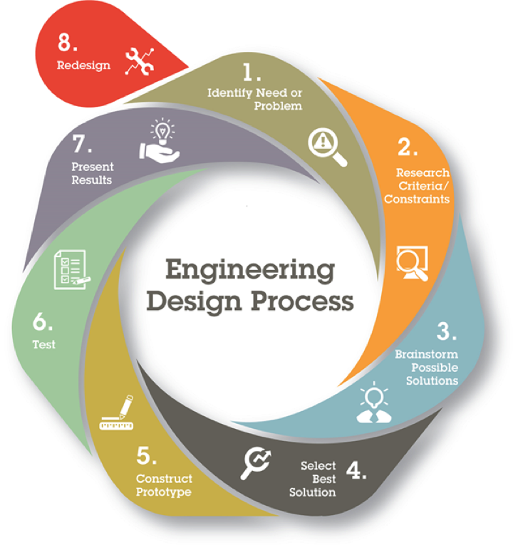
What is an engineer?
Engineers like to solve problems and work to make things more efficient. They work in teams to figure things out.
Failure is a normal part of the design process. It leads to learning.

