Slide 1
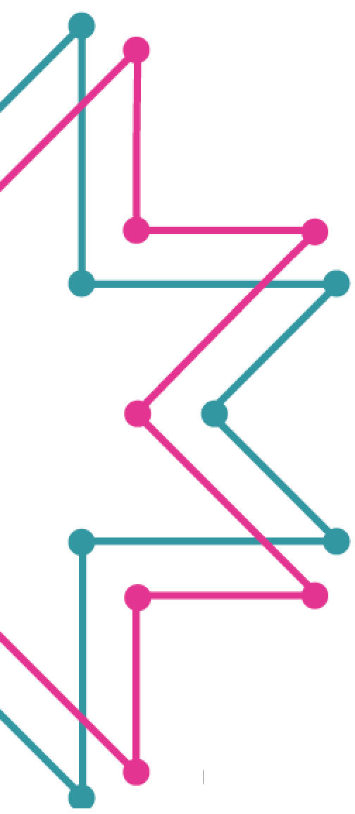
Welcome to Tech Tales!
Session 2

Slide 2
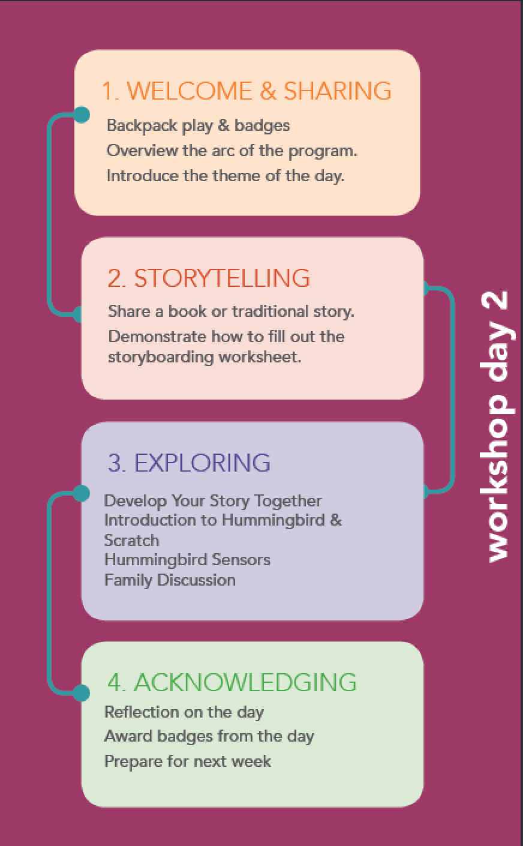
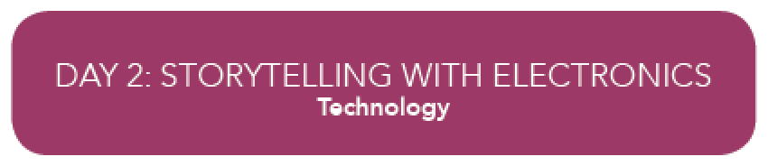

Slide 3
Theme of the Day: What is Technology?
Definition:
The application of scientific knowledge to develop:
machinery and equipment
a process or method that serves a practical purpose
The branch of knowledge dealing with engineering, applied sciences, and the industrial arts
Notes:
Discuss right after storytime

Slide 4

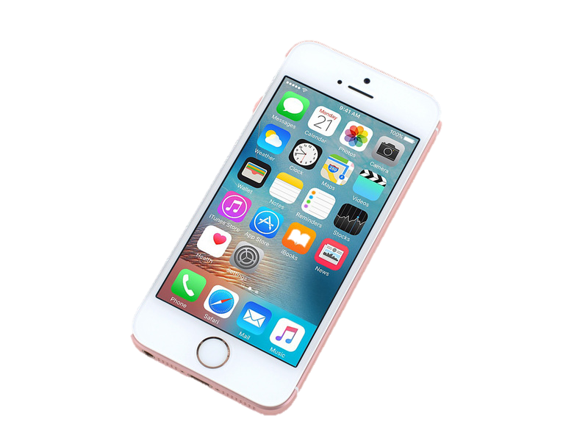
Examples of Technology
machinery
tools
equipment
methods
processes
Canoe carving
Navigation
Cell phones
Maps
Computers
Food preservation
…
Notes:
Discuss right after storytime

Slide 5
Selecting a Family Story for the Diorama
Three possible kinds of stories to consider…
Tell a story about an important experience in your family’s past
Tell a story about how your family and/or the world might change in 10 years
Tell a story about a place that is important to your family

Slide 6
The Hummingbird Microcontroller

Slide 7
Computer Login
Account: Tech Tales User
Password: tales

Slide 8
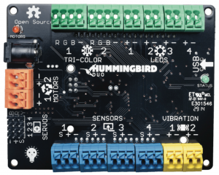
Hummingbird Duo
LED Ports
USB
Notes:
This is your Hummingbird Board. Other names: microcontroller, printed circuit board (PCB). Find the LED ports on your Hummingbird.

Slide 9
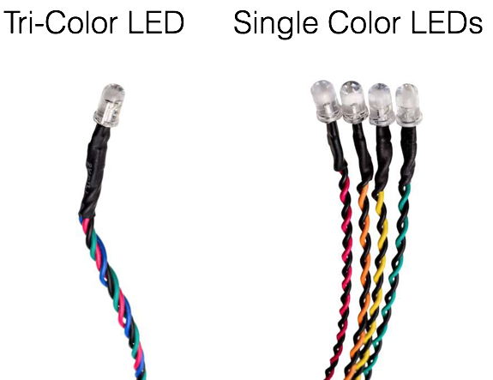
Notes:
The Hummingbird kit comes with two kinds of lights. We will be using the single color LEDs first.
You might have tried these out at home, but we’re going to go through it together, and you can ask any questions you have.

Slide 10
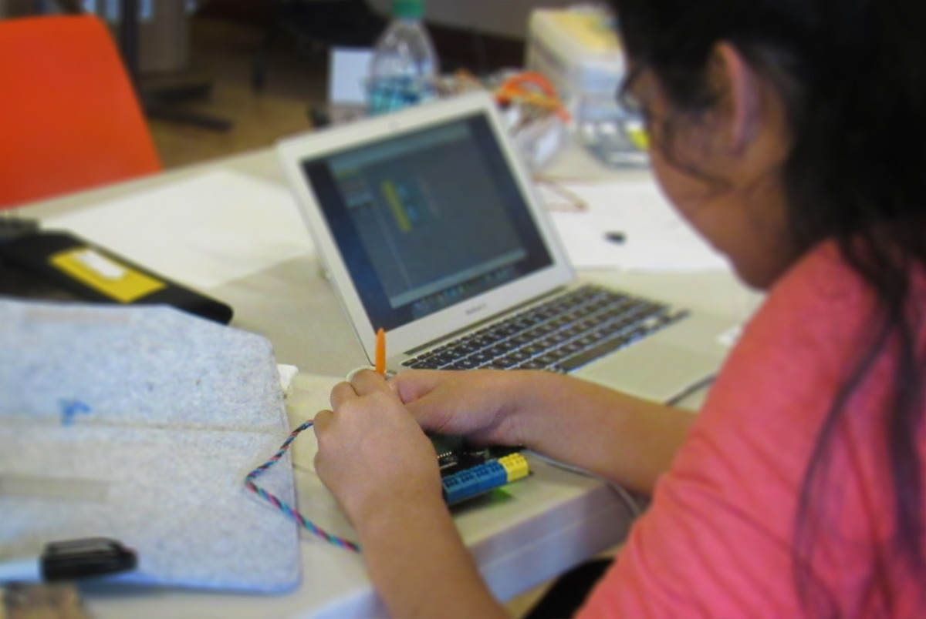
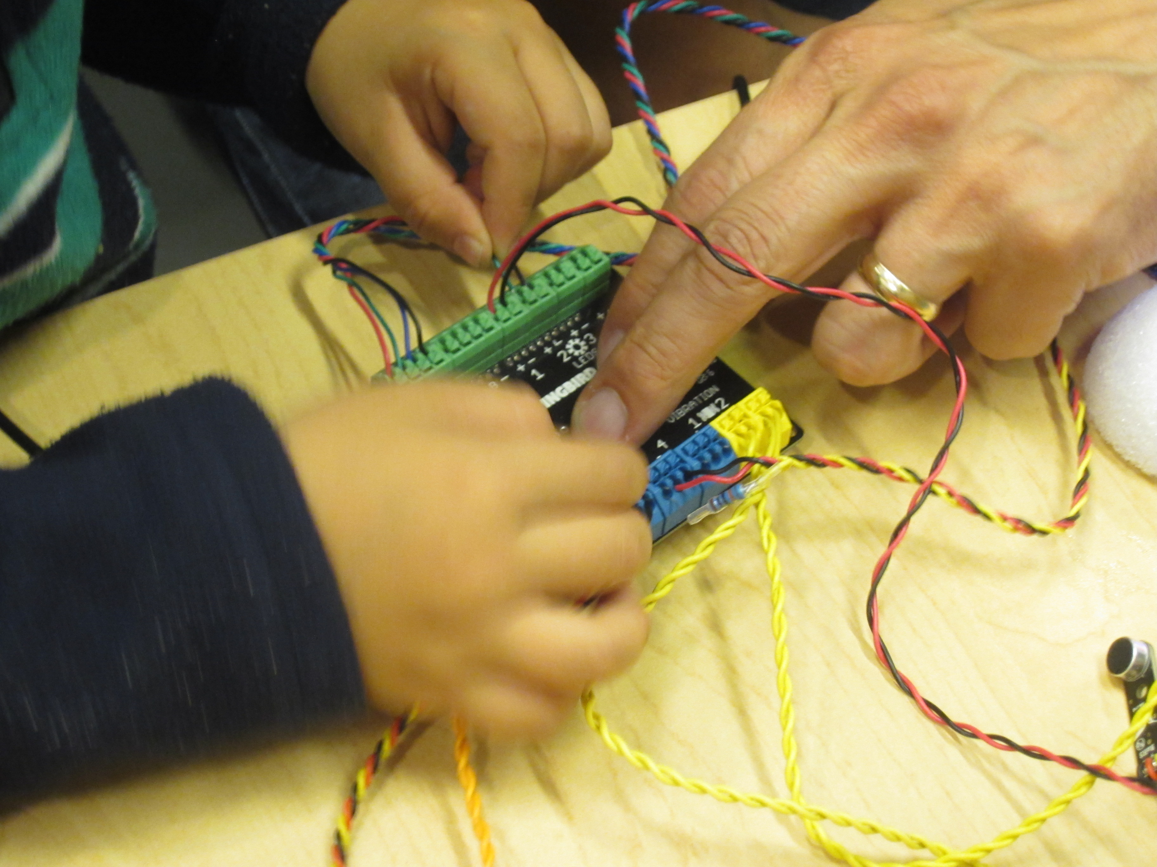
Connect LED
Notes:
Find the single color LED ports on your Hummingbird
Push down and hold the tab of the terminal with the orange terminal tool.
Insert the metal part of the wire at roughly a 45 degree angle.
Release the tab and gently tug the wire to make sure it is secure.
You might find it helpful for one person to push down the tab, and another person to insert the wire.

Slide 11

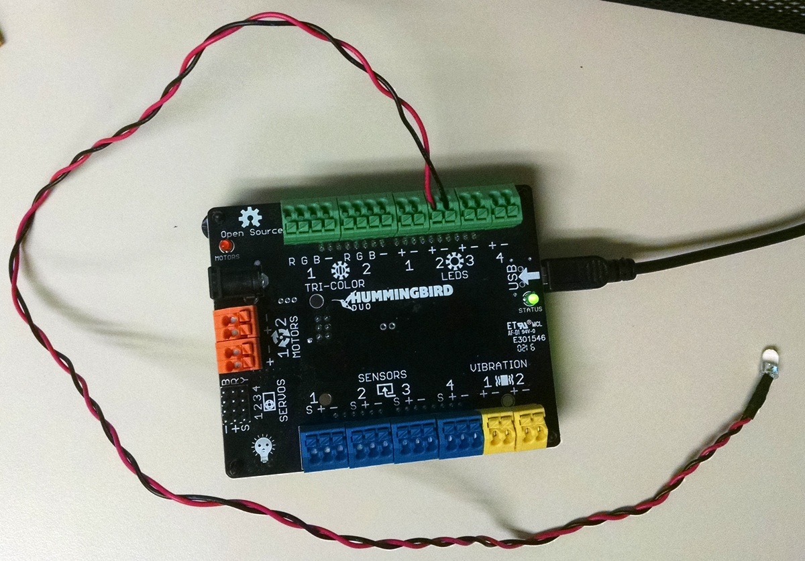
Single-color LED attached to LED port 2
Black wire is always NEGATIVE (-)
Notes:
These port numbers are how we let the Hummingbird and Scratch program talk to each other. It’s like sending a letter to an address.

Slide 12
Connect Hummingbird to Computer
USB
port
Notes:
Now connect your board to the computer with the USB cord

Slide 13
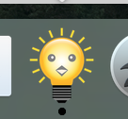
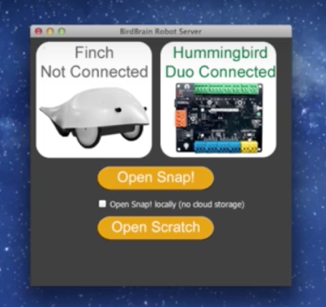
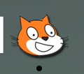
Birdbrain Robot Server + Scratch
Opens Scratch
CLICK
Notes:
After the Hummingbird is connected to the computer, open Birdbrain Robot Server.
**If the Hummingbird picture is grayed out, disconnect the Hummingbird, quit Birdbrain robot server, reconnect the Hummingbird, then restart Birdbrain robot server.
Click Open Scratch to start the program. (**If Scratch asks to use Adobe Air, say OK. This allows Scratch to run)

Slide 14
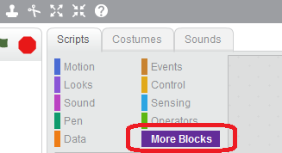
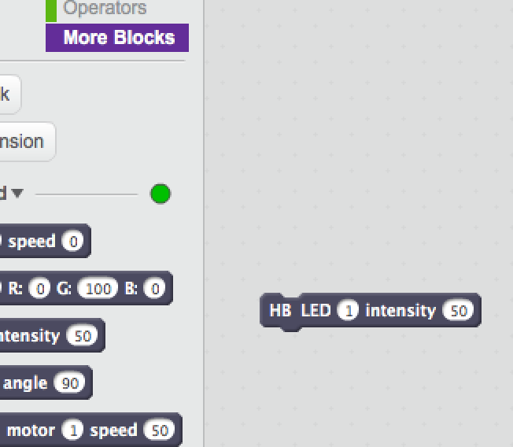
To control single-color LED
Click and Drag
Notes:
Find the Hummingbird blocks under More blocks under the Scripts tab. They are purple.
Find the block that says HB LED and drag it into the right gray part of the screen. This is where you will put your program.
The first number is the port that the LED is connected to. The second number tells it how bright to be from 0-100. 0 is no power, 100 is full power.
**If you don’t see the Hummingbird blocks, disconnect the Hummingbird, quit Scratch, quit Birdbrain robot server, reconnect the Hummingbird, then restart Birdbrain robot server, and click on the Open Scratch button.

Slide 15
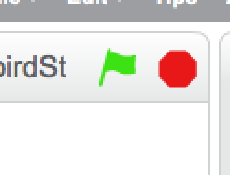
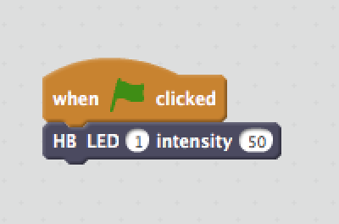
Add Events
When do you want the light to turn on?
Stop the program and start it again after you make changes
Turn on LED at port 1 to half power when the flag is clicked
Notes:
Find the Events blocks from the Scripts tab. They are dark orange.
These are events that cause something to happen.
There are several options for events such as key presses and icons to click on.

Slide 16
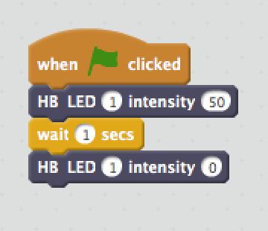
Adding Controls: Delay
How long do you want the light on?
Turn on
Stay on for 1 second
Turn off
Notes:
Find the Control blocks. They are light orange/dark yellow.
These control the actions we are telling the hummingbird to do.

Slide 17
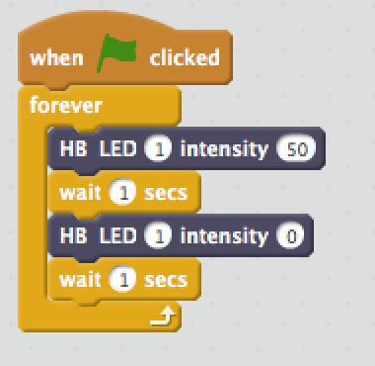
More Controls: Repeat
To blink forever, repeat your program forever
Repeat everything inside this block forever
Notes:
Add a forever block around your actions to make it repeat forever in a loop.

Slide 18
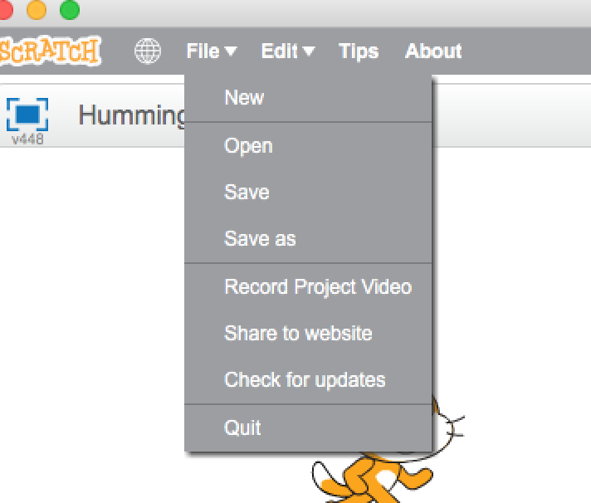
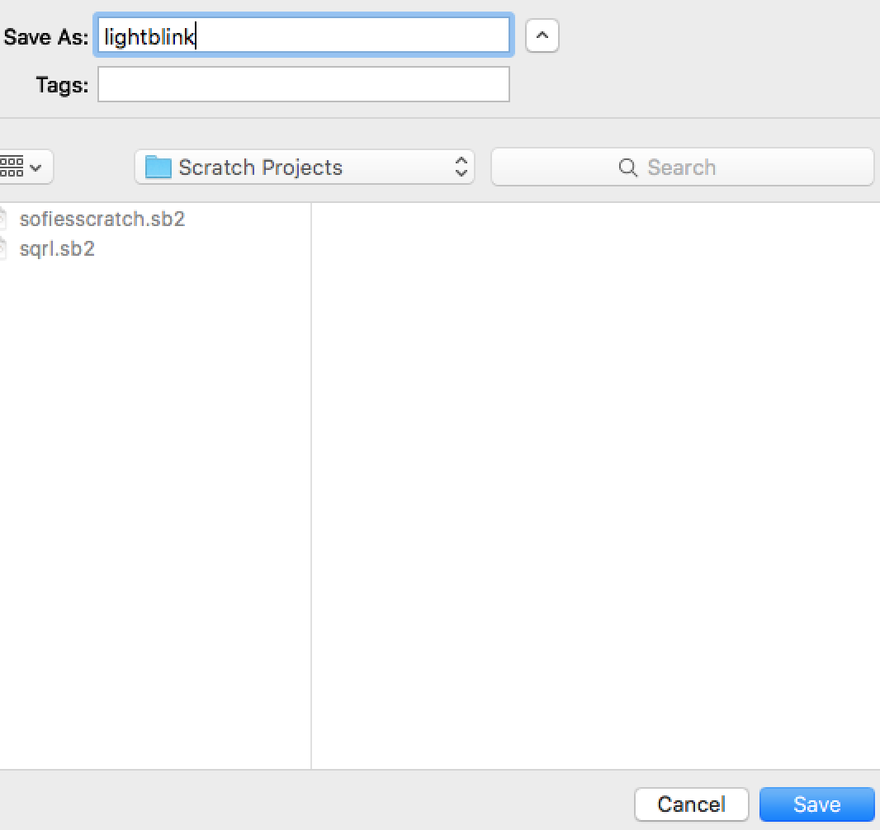
Save your program
Notes:
Save your program with a name that describes what it does, like lightblink
Save it to a place that is easy to find on your desktop or under Scratch Projects.

Slide 19
Sensors: How the Microcontroller Gets Information from the World

Slide 20
Inputs
Notes:
The Hummingbird sensors are input devices. They send information to the Scratch program.

Slide 21
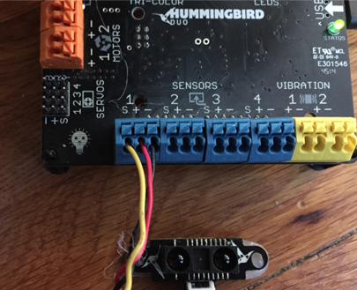
Distance Sensor attached to Sensor port 1
Black wire is always NEGATIVE (-)
Red wire is POSITIVE (+) on sensors
Yellow wire sends information (S for serial data)
Notes:
These port numbers are how we let the Hummingbird and Scratch program talk to each other. It’s like sending a letter to an address.
The positive and negative wires make a complete circuit.
The yellow wire takes the input that sensor receives and sends it to the Hummingbird.

Slide 22

Sensor blocks
Click to see value the sensor is picking up
Notes:
Find the Hummingbird blocks under More blocks under the Scripts tab. They are purple.
Find the block that says HB distance sensor and drag it into the right gray part of the screen.
Click on it to find out what value it is sensing. The numbers are distance in centimeters.

Slide 23
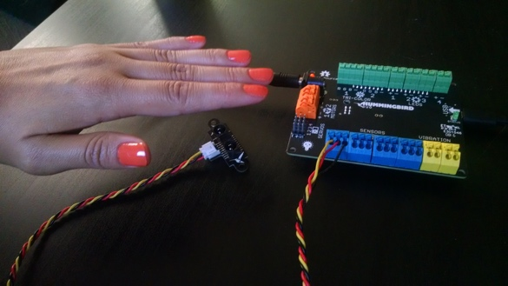

Hold something in front of the sensor and click the block again.
Is the number different?
This is the distance it is sensing in centimeters.
Notes:
Keep the sensor still in one place and hold something in front of it.
**This is an infrared sensor. It sends a beam of infrared light out and measures how long it takes for the beam to be reflected back. This is how it measures distance.

Slide 24
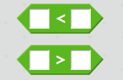
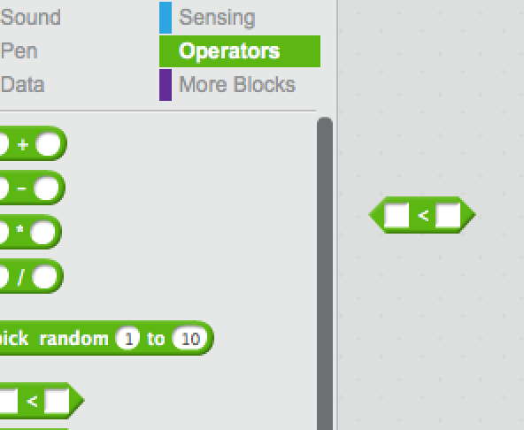
Sensor as a switch
Use the distance sensor to trigger an action
Less than
Greater than
Notes:
Find the Greater and Less Than blocks under the Operators menu. They are green.
Hungry alligator wants to eat the bigger number:
Mouth open to the right is less than (First number is less than the second number)
Mouth open to the left is greater than (First number is greater than the second number)
(Or Arrow points to the smaller number)

Slide 25

Comparing Values
How far from the sensor do you want something to be to trigger an action?
Input from distance sensor
Greater than
30 cm
Notes:
Drag the distance sensor block into the first open square of the comparing block.
The value that the Boolean block uses to make a decision is called the threshold.
In this case, the threshold is 30 cm.
Create the Boolean block shown. This block is true if the value of the distance sensor is greater than 30 cm, and false otherwise.

Slide 26
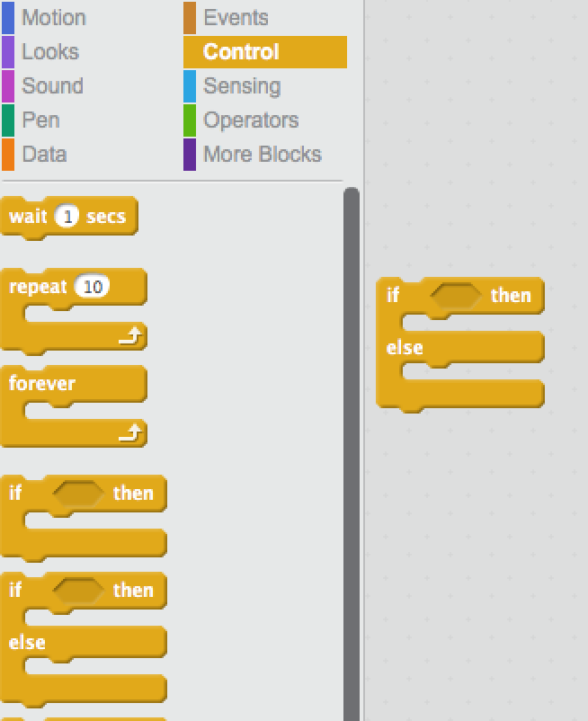
Test
Test if the condition we set is true, and do something
If (this is true)
Then (do this)
Else (do this other thing)
Notes:
We have blocks that do comparing, but it doesn’t actually make anything else happen. We want to do something with that information! For that we need some controls.

Slide 27
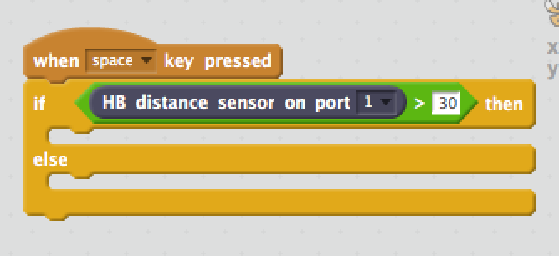
Test
When space bar pressed,
Test if
Distance sensor value is
Greater Than
30 cm
Then (do this)
Else (do this other thing)
Notes:
We have blocks that do comparing, but it doesn’t actually make anything else happen. We want to do something with that information! For that we need some controls.
Choose the If/Else/Then block (NOT the If/Else block)
Drag your green diamond into the IF section of the block.
We are setting an event, telling the hummingbird to listen for the space bar to be pressed.
When that happens, it tests if the input from the distance sensor is greater than 30 cm.
Now let’s make something happen!

Slide 28
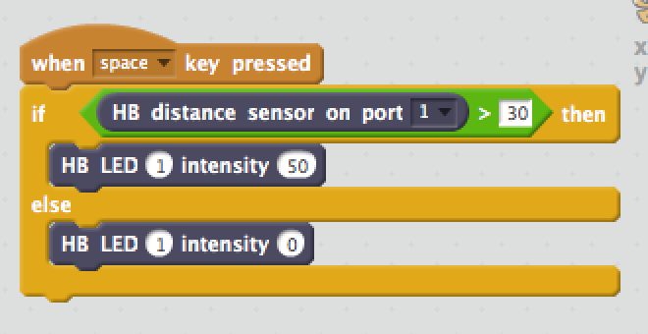
Make something happen
If this is true, then
Turn LED on 50%
Otherwise,
Turn LED off
Notes:
We want to turn on the light if the sensor is triggered, but keep it off the rest of the time. This is like when you walk into a bathroom with a motion sensor. The light is off unless the sensor is triggered. ”Else” is the default.
Drag your LED blocks into the “jaws” of the if/else block. The first block will be what happens when the statement is true, in this case, set LED at port 1 on to half brightness.
The second block will be what happens the rest of the time (set LED at port 1 off).
**motion sensors are sometimes infrared (IR) sensors like this one, or they may use sonar or laser. There are many ways to accomplish similar tasks, and different tools are better suited for certain tasks. This sensor is good for measuring objects right in front of it.

Slide 29
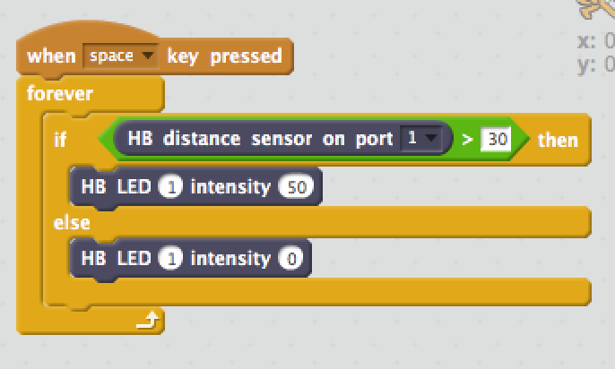
Keep doing it
Keep sensing forever
*This is important to make the sensor work
Notes:
Add a forever block around your actions to make it repeat forever in a loop.
We use the Forever block to keep the program running in a loop, continuing to sense distance.
If we did not use the forever block, the sensor would test the distance once, then the program would stop, just like when you clicked on the sensor block alone.

Slide 30
Save your program
Notes:
Save your program with a name that describes what it does, like distancesensor
Save it to a place that is easy to find on your desktop or under Scratch Projects.

Slide 31
Wrap Up

Slide 32
Theme of the Day: What is Technology?
Definition:
The application of scientific knowledge to develop:
machinery and equipment
a process or method that serves a practical
The branch of knowledge dealing with engineering, applied sciences, and the industrial arts
What technologies did we explore today?
What are some technologies that are important to you and your communities?
Notes:
Discuss right after storytime

Slide 33







What badges did you earn today?
Family Badge

Slide 34
Home Play

